Slide 1






FU HOUSE FINDER
Tìm nhà theo cách của bạn

Slide 2


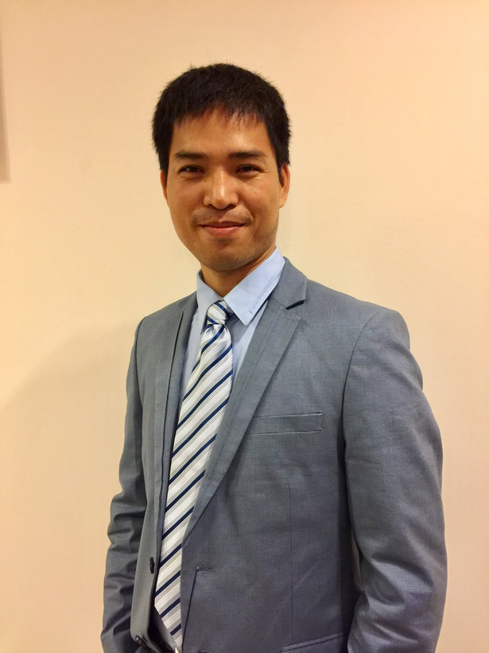
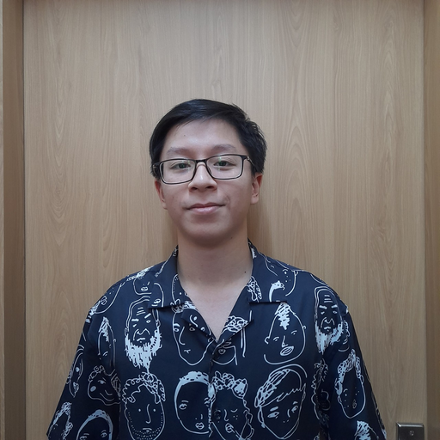


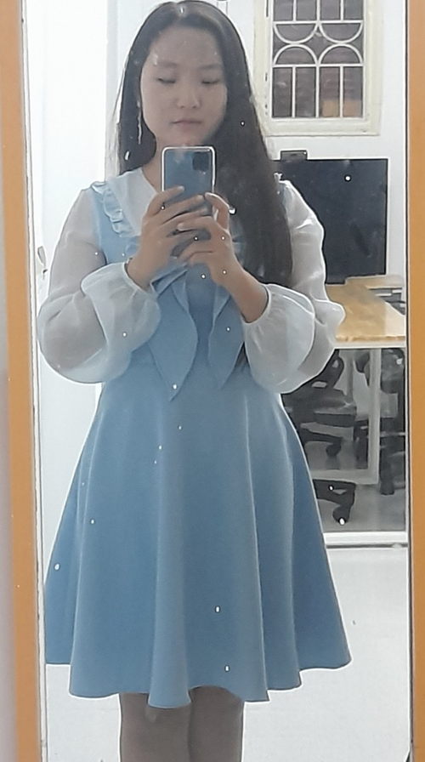

Mr. Nguyen Tat Trung
Supervisor
Nguyen The Giang
Team Leader
Bui Ngoc Huyen
Team Member
Phung Quang Thong
Team Member
Nguyen Thu An
Team Member
Nguyen Tri Kien
Team Member

Slide 3
CONTENT
1
PRODUCT BACKGROUND
2
PROJECT MANAGEMENT PLAN
3
REQUIREMENT SPECIFICATION
4
SOFTWARE DESIGN
5
TESTING
6
LESSON LEARNED
7
DEMO – Q&A

Slide 4

1. PROJECT BACKGROUND
Notes:
Background
Existing system
Idea
Vision
Opportunity
Scope, out of scope

Slide 5
Nguồn: Phòng Tuyển sinh Đại học FPT (ngày 20/12/2022)
Notes:
Thực trạng: số lượng sinh viên ngày một đông,… số liệu….
Kí túc xá (6 dorm, chưa đầy 4000 chỗ, gần đây còn được trưng dụng thêm cho học sinh cấp 3, sập hệ thống ocd ☺), không thể đáp ứng hết nhu cầu chỗ ở cho toàn bộ sinh viên trong trường
->Việc tìm nhà trọ trở nên phổ biên, cao điểm vào mỗi mùa tuyển sinh, tuy vậy vẫn còn rất nhiều khó khan, trở ngại
Số lượng sinh viên thuê ngoài lớn, thông tin nhà trọ đã được xác thực ít, khó tiếp cận đến sinh viên

Slide 6
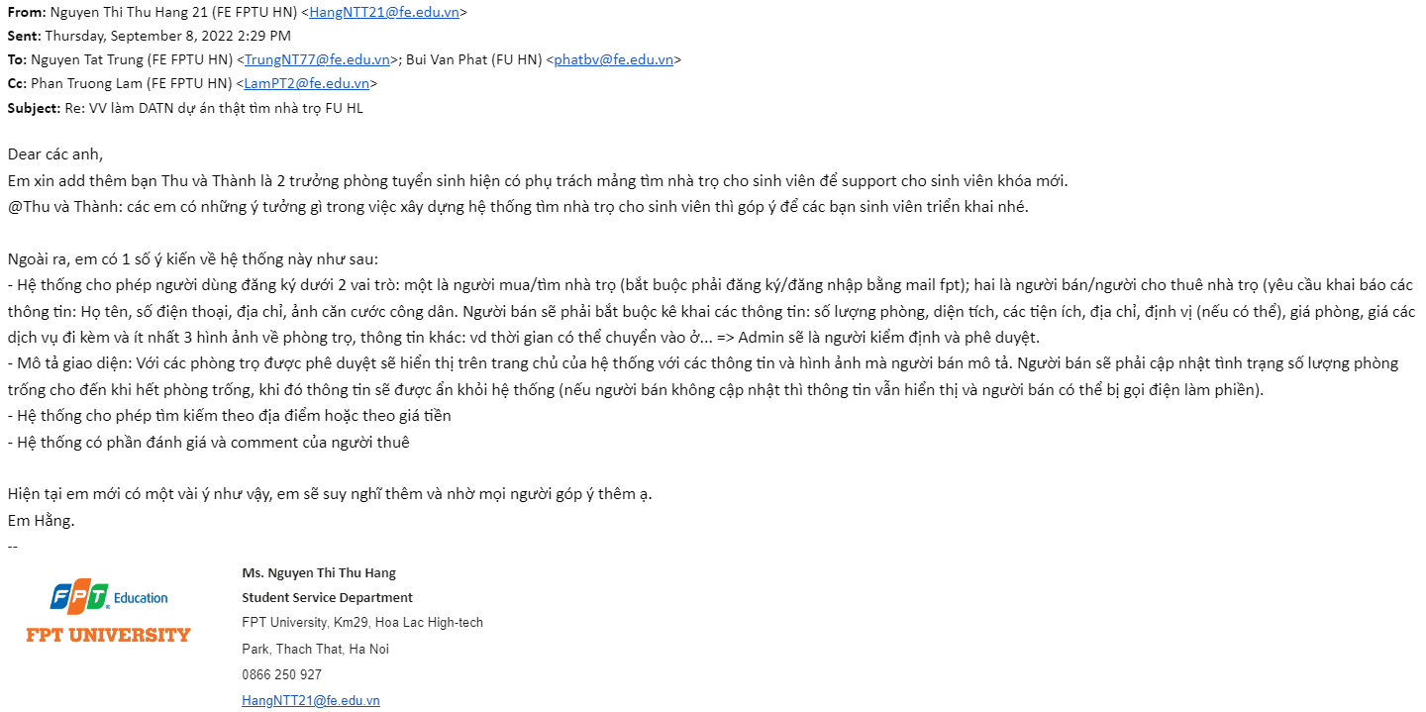
Requirements from FPT University
Email from Student Service Department to describe requirements

Slide 7
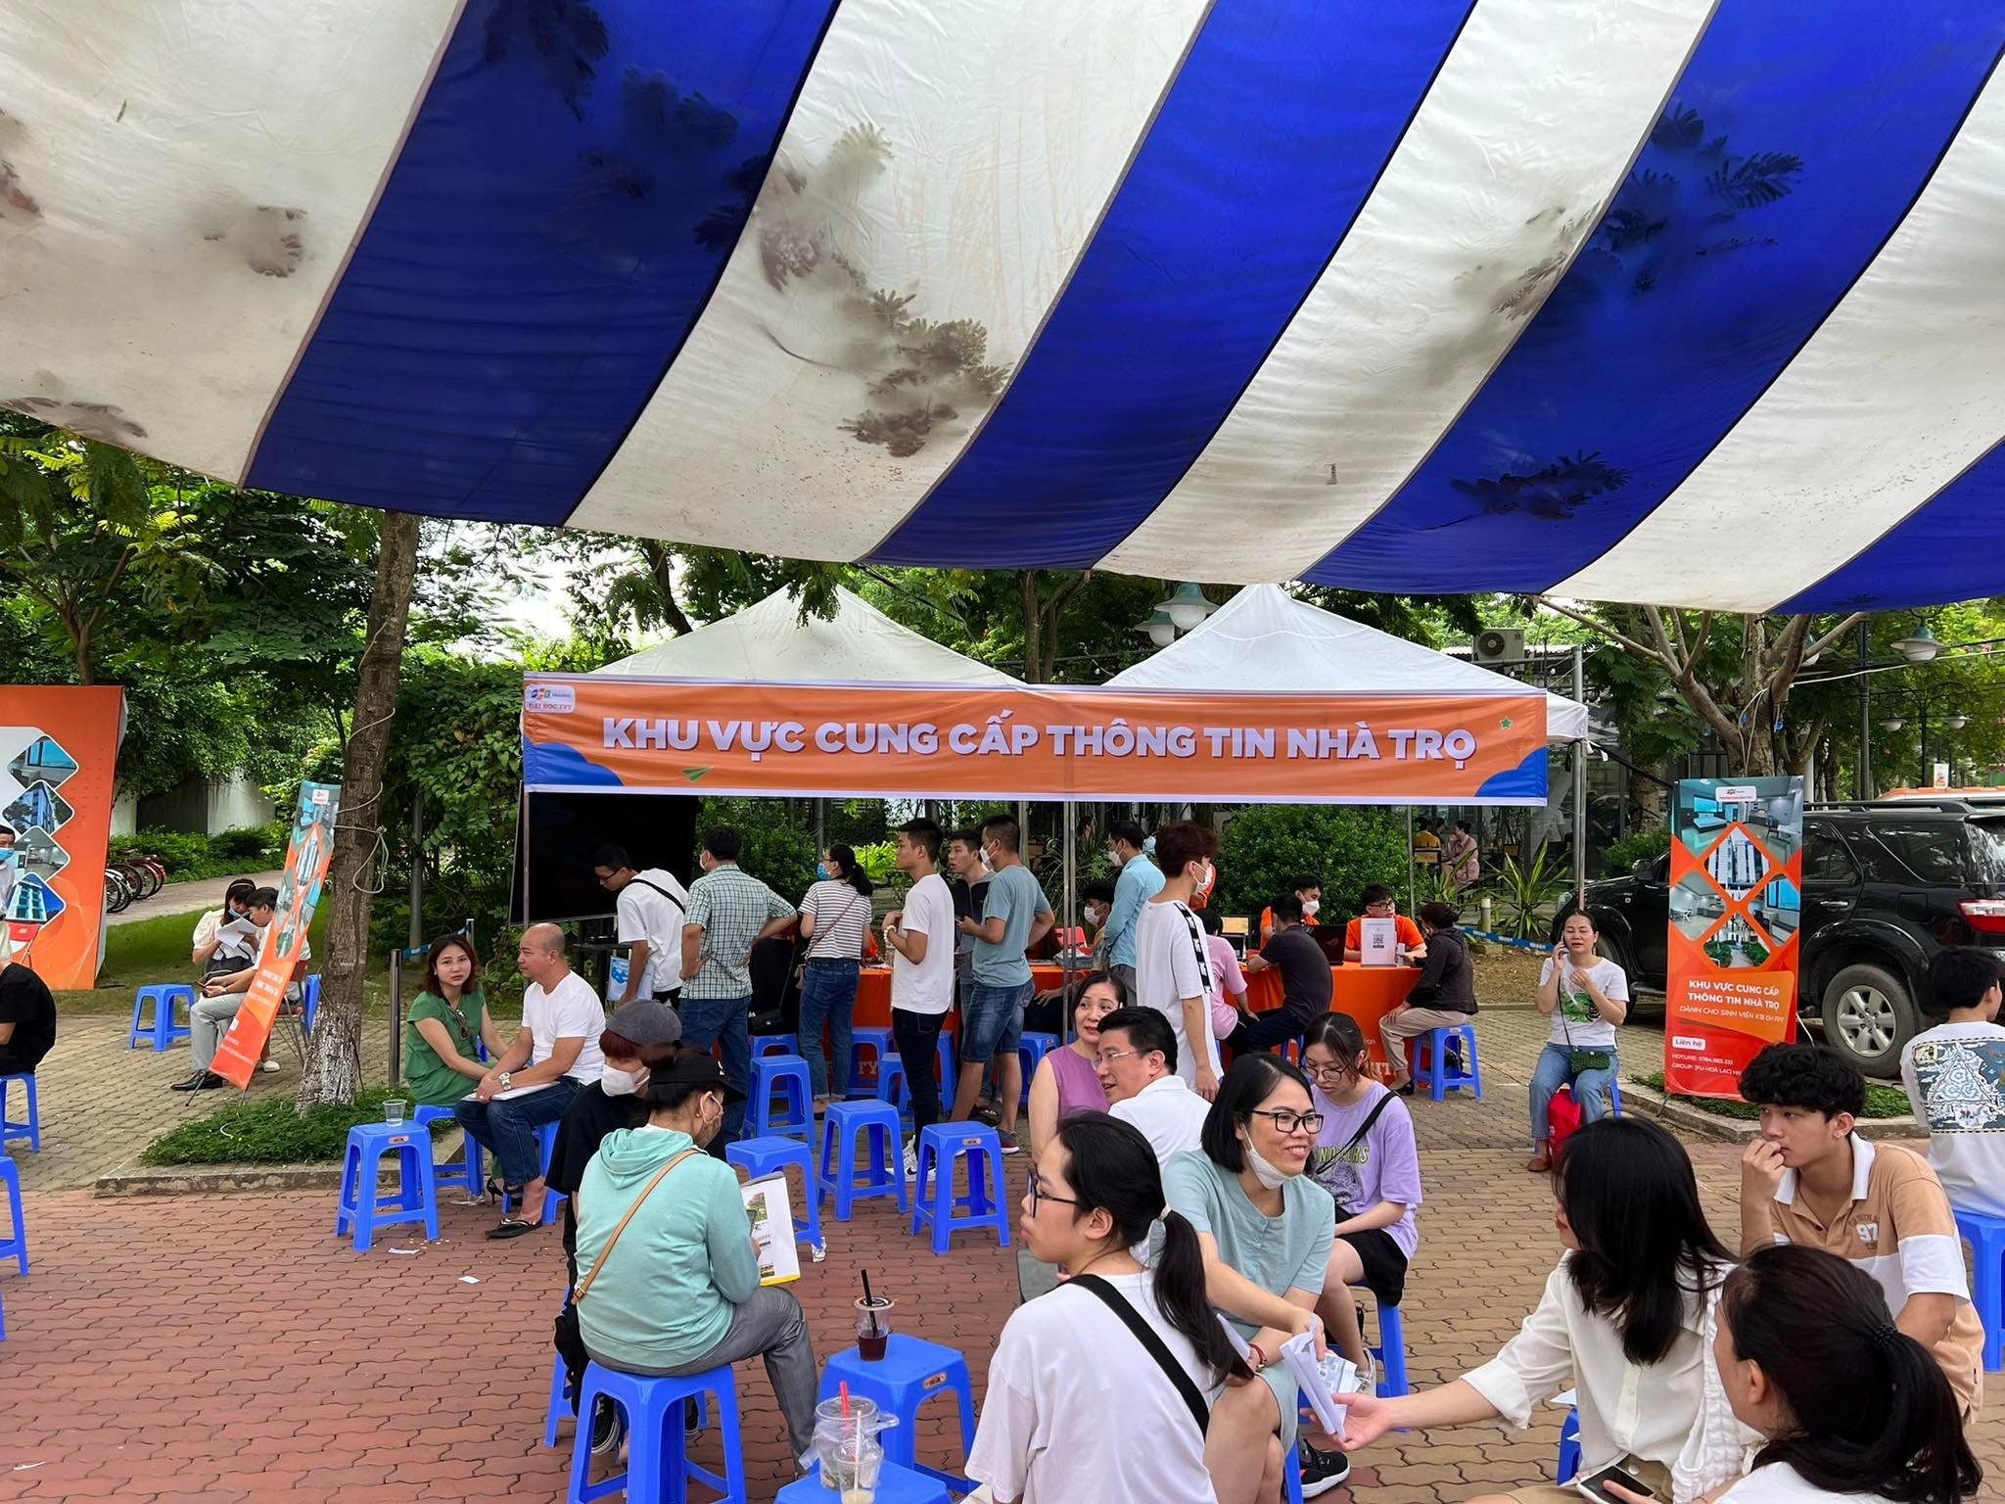
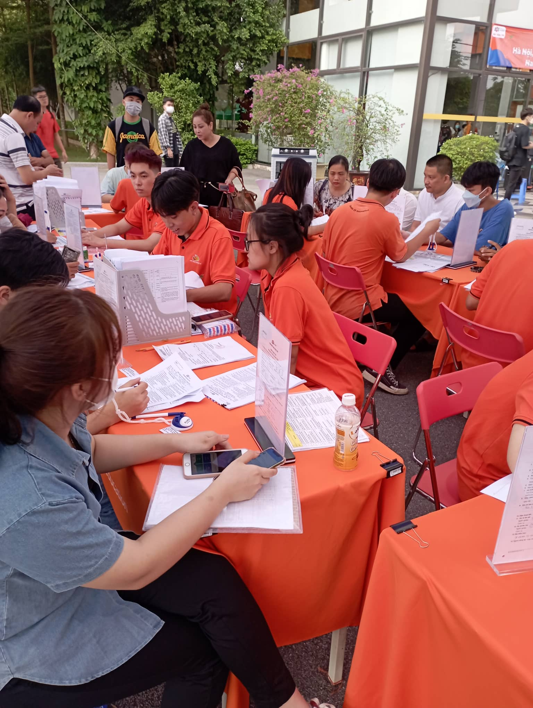
TRADITIONAL METHOD
Notes:
Cách làm truyền thống:
Tuyển sinh đang phải thu thập thông tin một cách thủ công, gọi điện đến chủ trọ hằng ngày để cập nhập thông tin phòng trống
Tốn tiền thuê nhân công nhưng vẫn không thể đáp ứng số lượng sinh viên, phụ huynh
Không có địa chủi nhà cụ thể, khó tìm kiếm trong khu vực
-> Tốn thời gian nhưng không đem lại hiệu quả

Slide 8
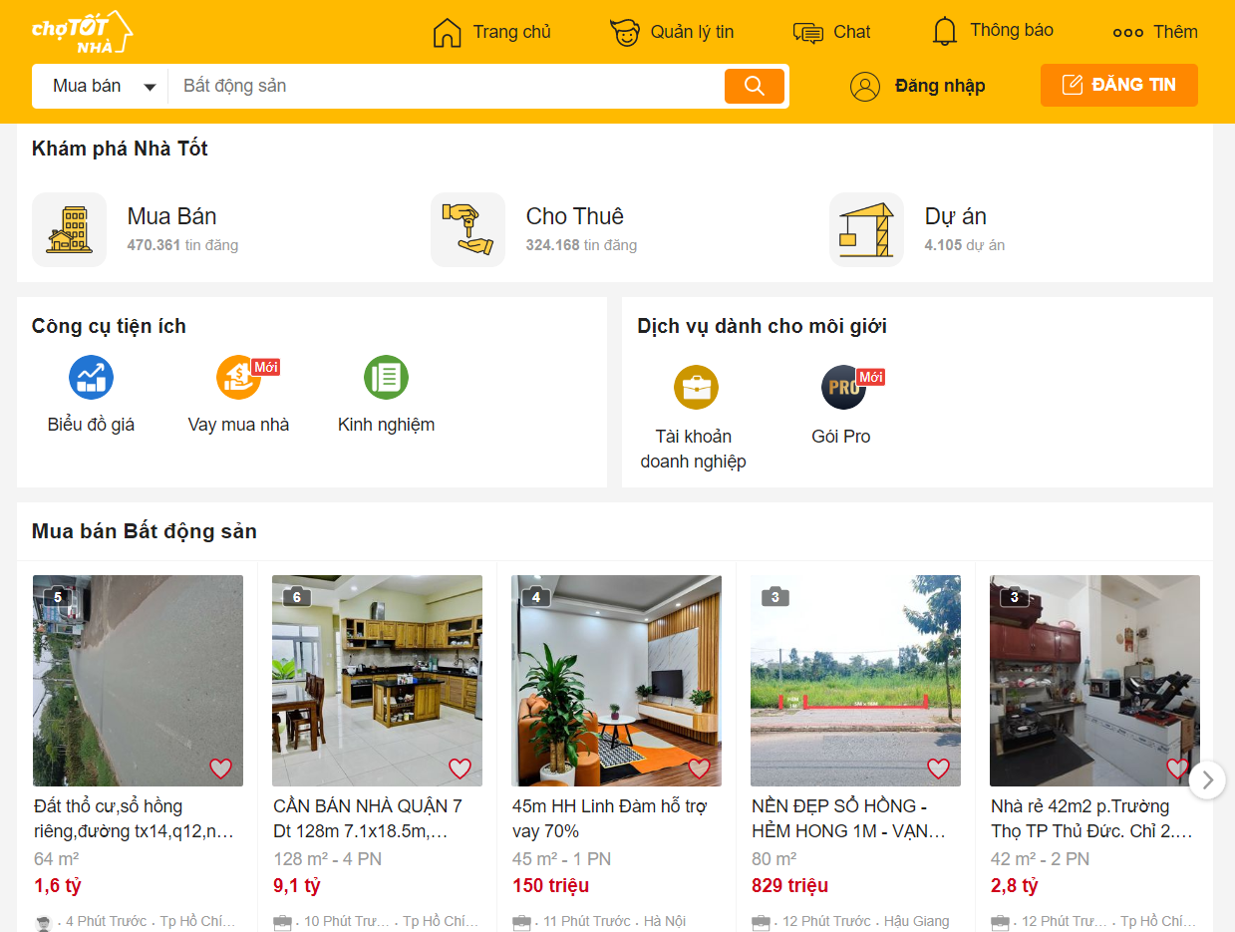

EXISTING SYSTEM
User-friendly interface
Verified information
Not focus on a specific area
Not provide information for rental
Students are not target customer
Notes:
Pros:
Giao diện đẹp
Thông tin được xác minh
Cons:
Chưa cụ thể đến từng khu vực
Đối tượng hướng đến là người đã đi làm, có thu nhập từ mức khá đổ lên
Không có thông tin phòng trọ
Phù hợp để mua nhà, thuê chung cư cao cấp hơn,

Slide 9
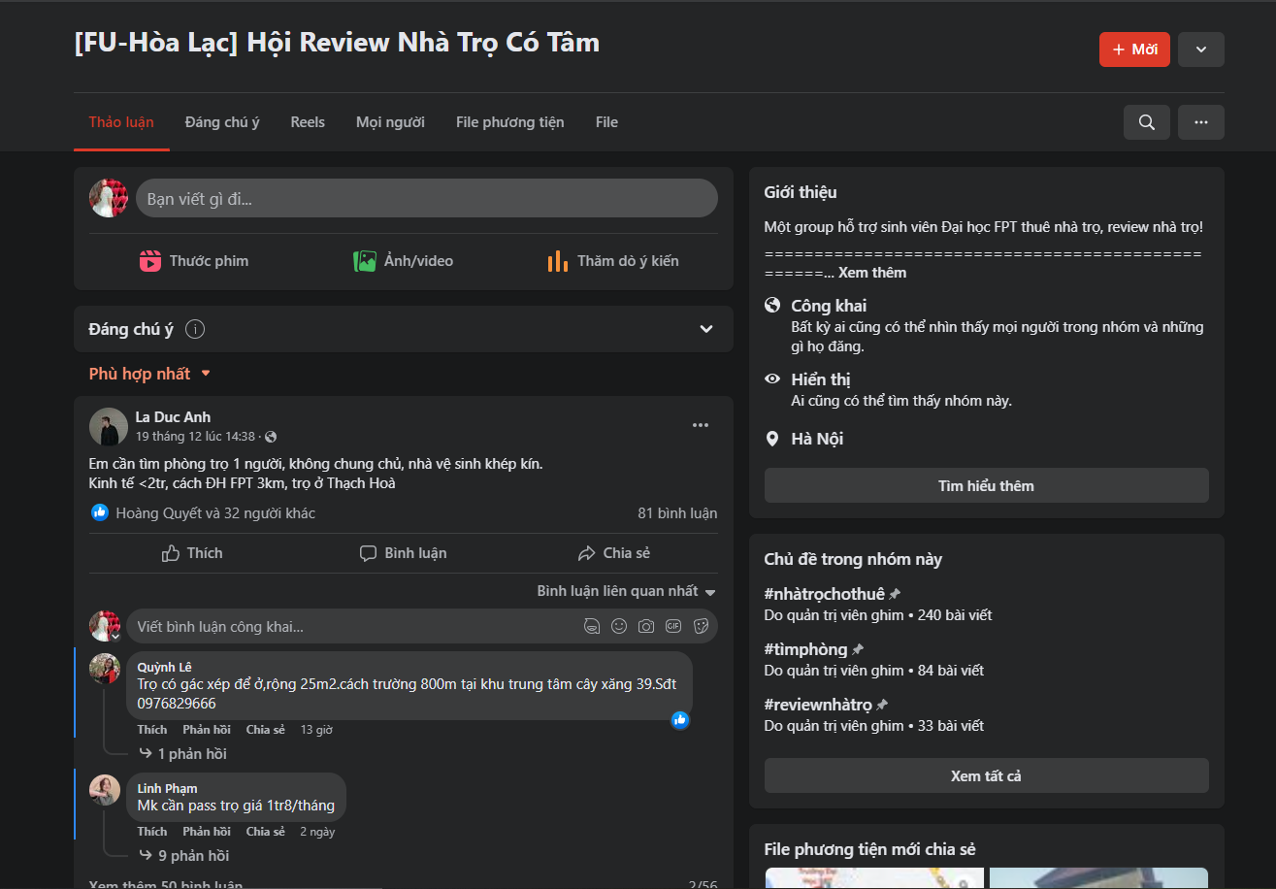
EXISTING SYSTEM
Easy to use
Focus on a specific area
Poor information
Notes:
Pros:
Dễ sử dụng
Cons:
Thông tin chưa được chắt lọc, verified
Sinh viên đăng bài tìm trọ
Chở hàng đăng bài spam
Data phân tán, mỗi lần post lên chỉ post dc thông tin có phòng cho thuê, ko cụ thể (có bao nhiêu phòng, có bao nhiêu người cho thuê dc…)
FU Hòa Lạc, Pass KTX Trọ

Slide 10
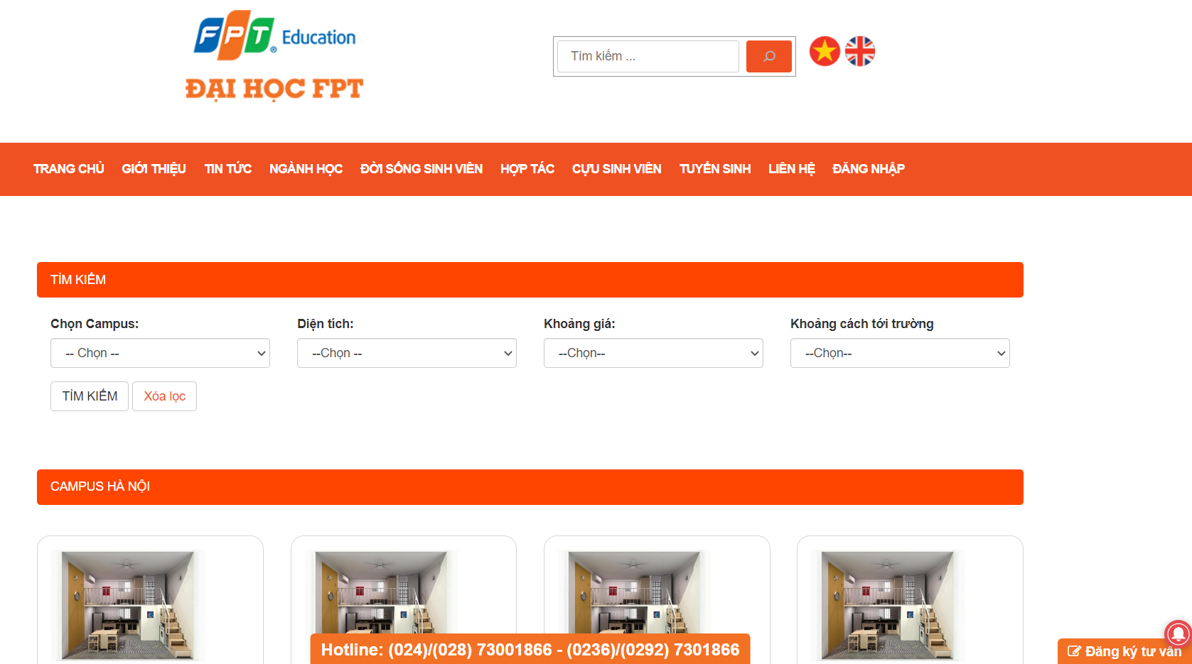
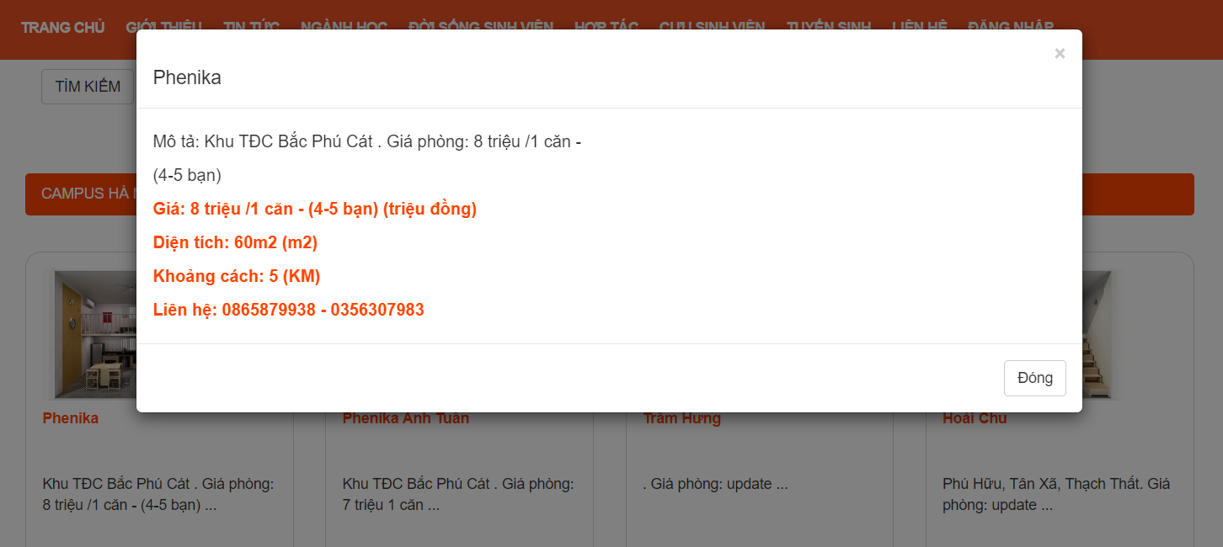
EXISTING SYSTEM
Reliable website
Simple navigation
Limited information
Notes:
Pros:
Giao diện đẹp
Trang chính thống
Dễ tiếp cận đến sinh viên
Cons:
Thông tin chưa đầy đủ, chuẩn xác (VD: hình ảnh chưa có, giá phòng còn đang hiển thị update)

Slide 11
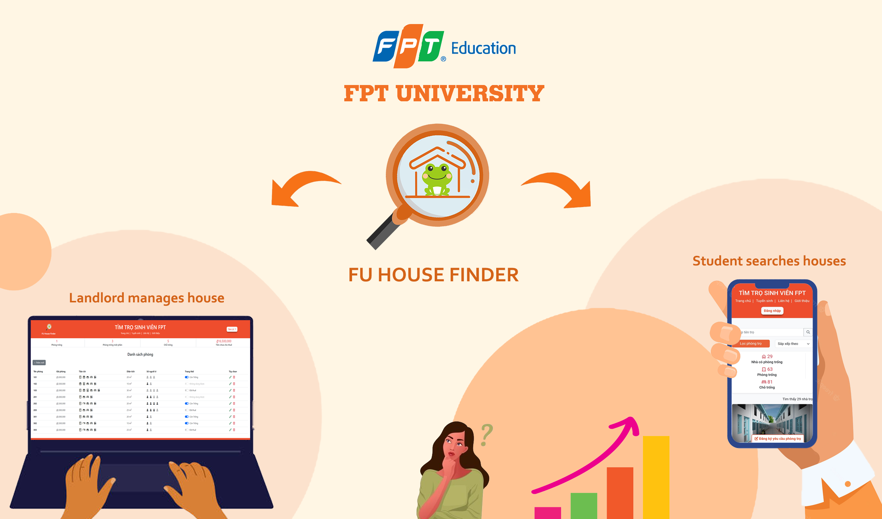
OUR IDEA

Slide 12
PROJECT SCOPE
IN SCOPE
OUT OF SCOPE
Connect students and landlords
Provide accurate, latest rental information
Review/Report a house
Collect statistics
Manage room history
Manage room issues
Translate into English
Notes:
Về phạm vi của dự án
Tuy nhiên thời gian có giới hạn -> làm trong tương lai

Slide 13
2. PROJECT MANAGEMENT PLAN

Slide 14
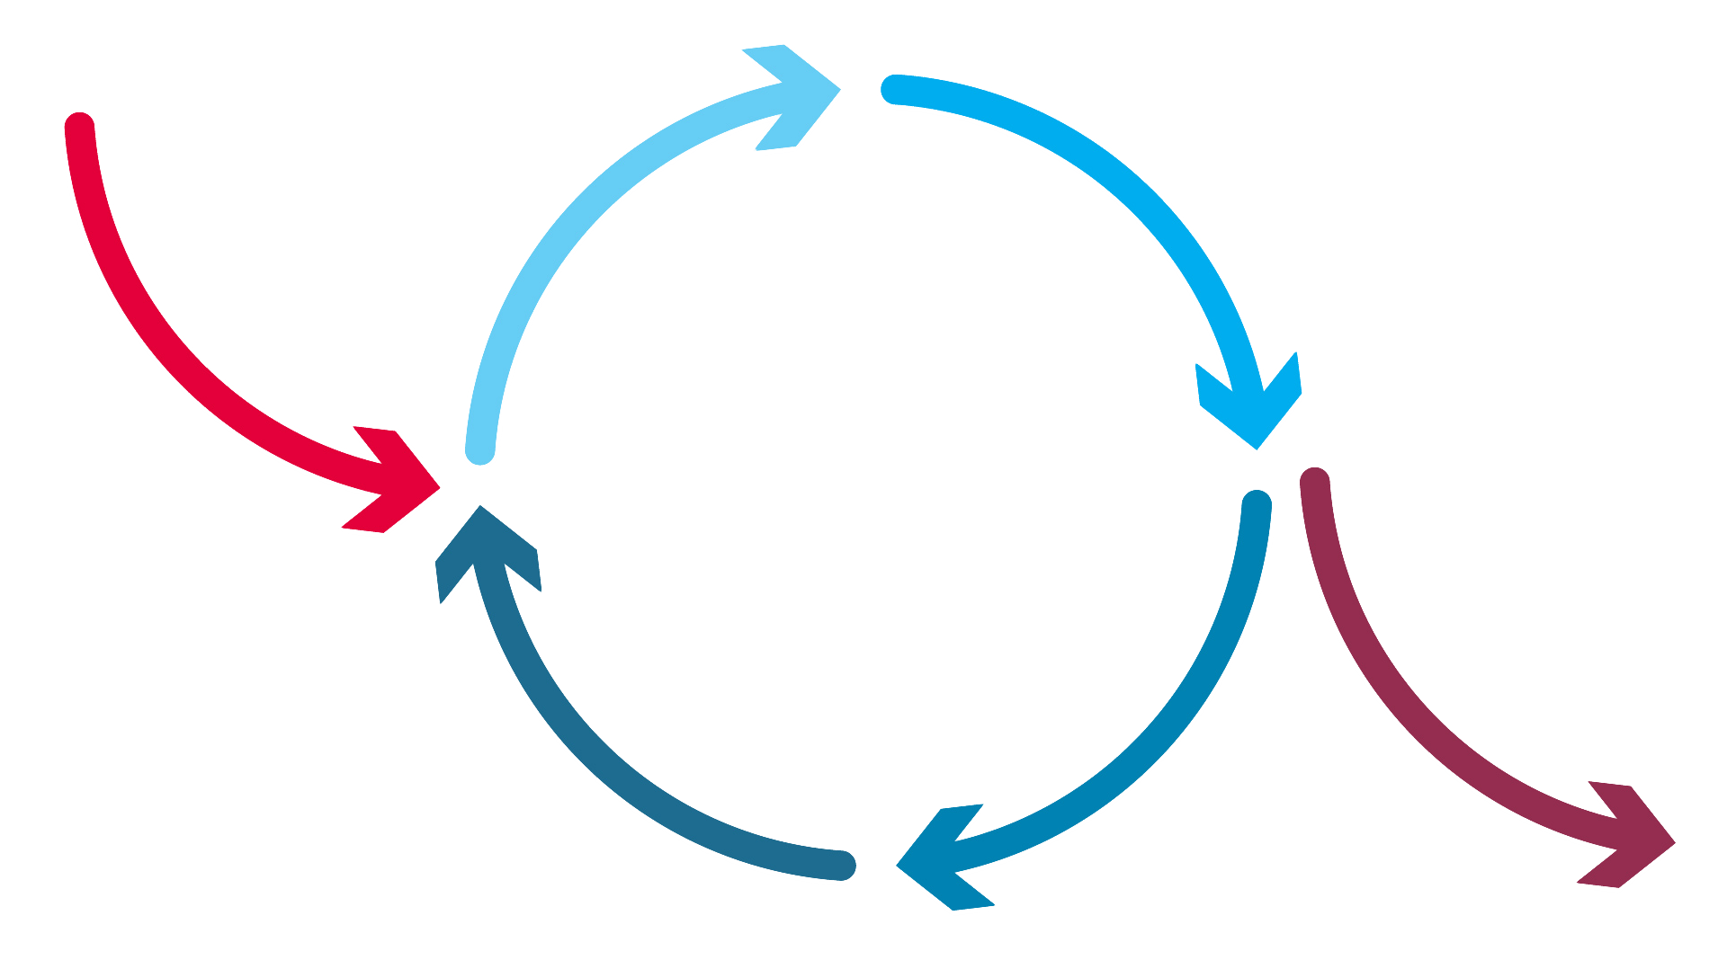
PROJECT PROCESS
REQUIREMENT
ANALYSIS & DESIGN
PLANNING
IMPLEMENTATION
INITIAL
PLANNING
Iterative &
Incremental
DEPLOYMENT
EVALUATION
TESTING
Notes:
Done

Slide 15





TEAM WORK
Time
6 hours/day, 5 days/week
Team Meeting
Everyday at 8p.m
Location
FPT University
Meeting with Supervisor
Once a week
Communication
Discord, Messenger

Slide 16
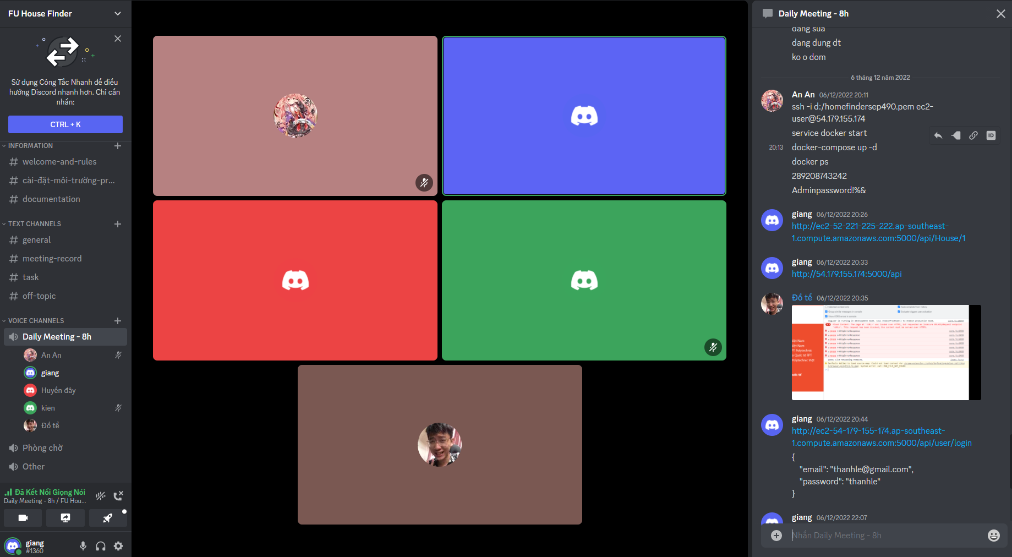
TEAM WORK
Daily Meeting

Slide 17
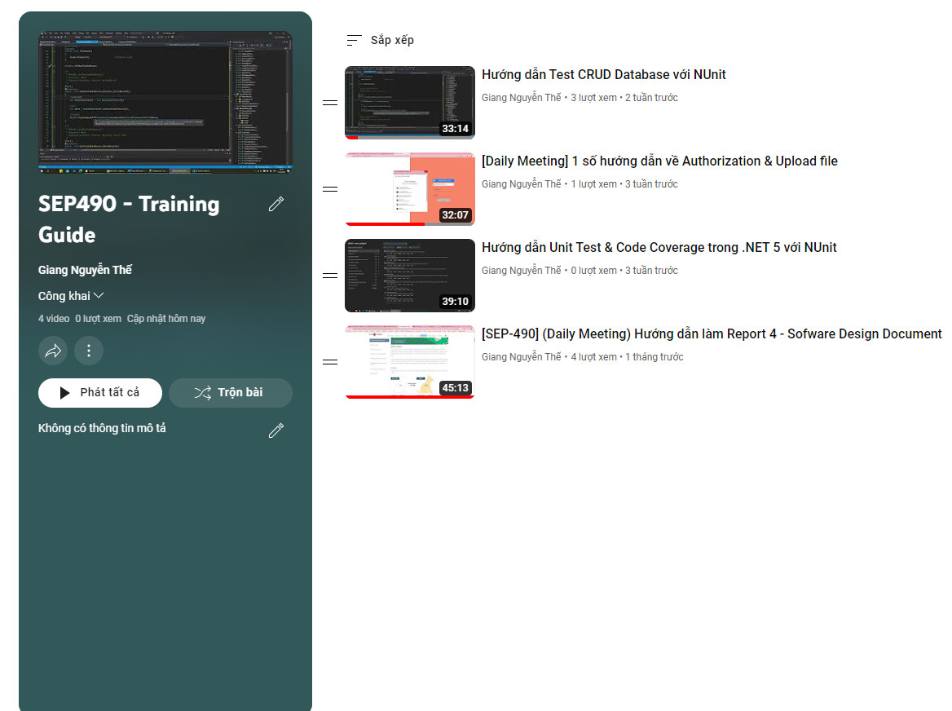
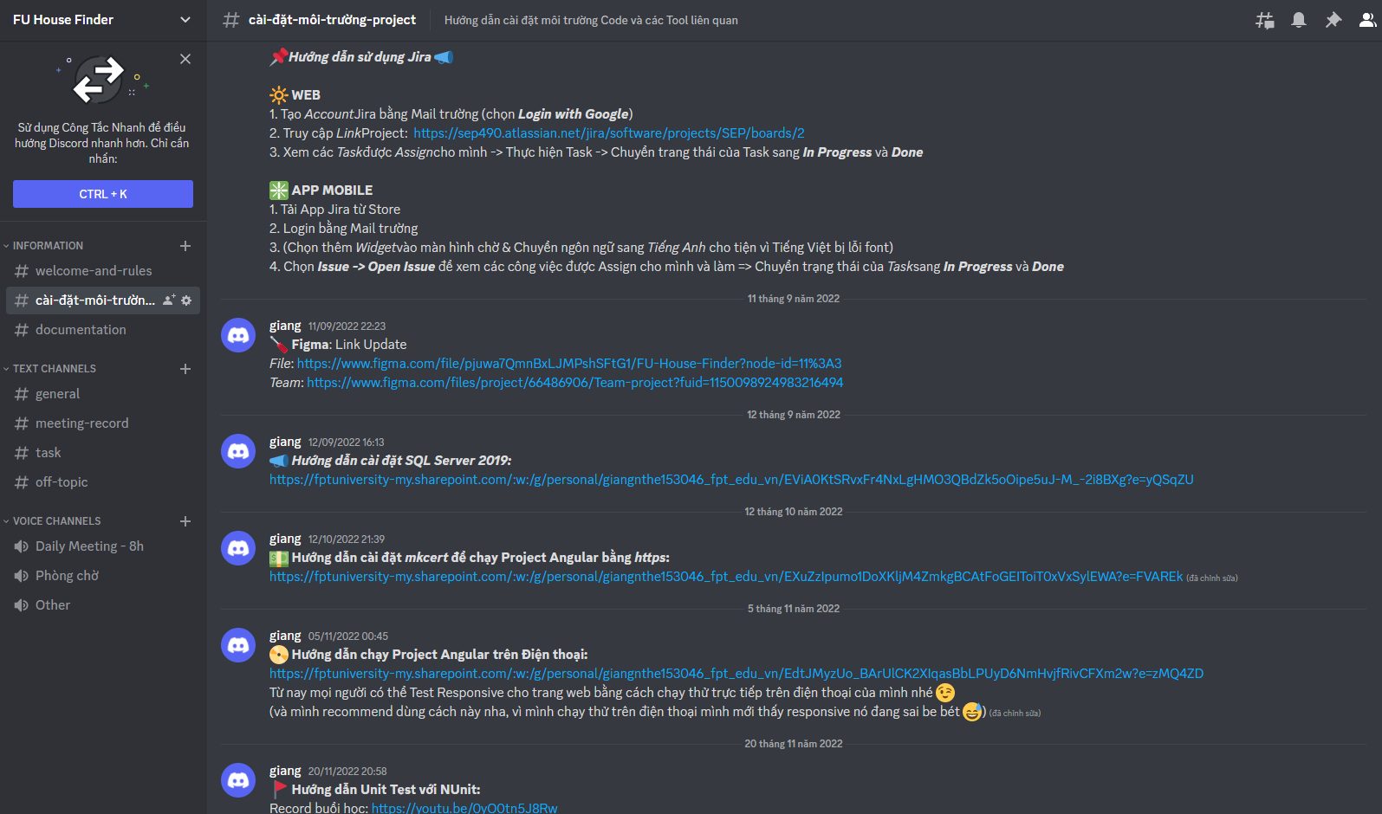
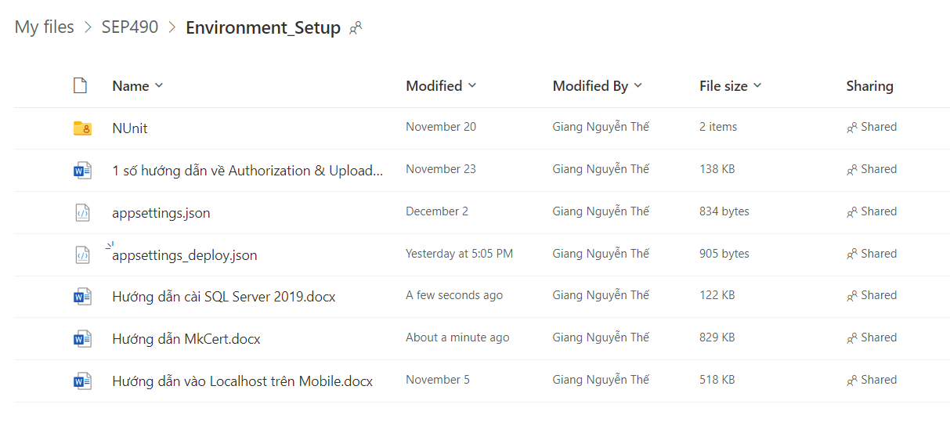
TEAM WORK
Training - Video
Training - Document

Slide 18
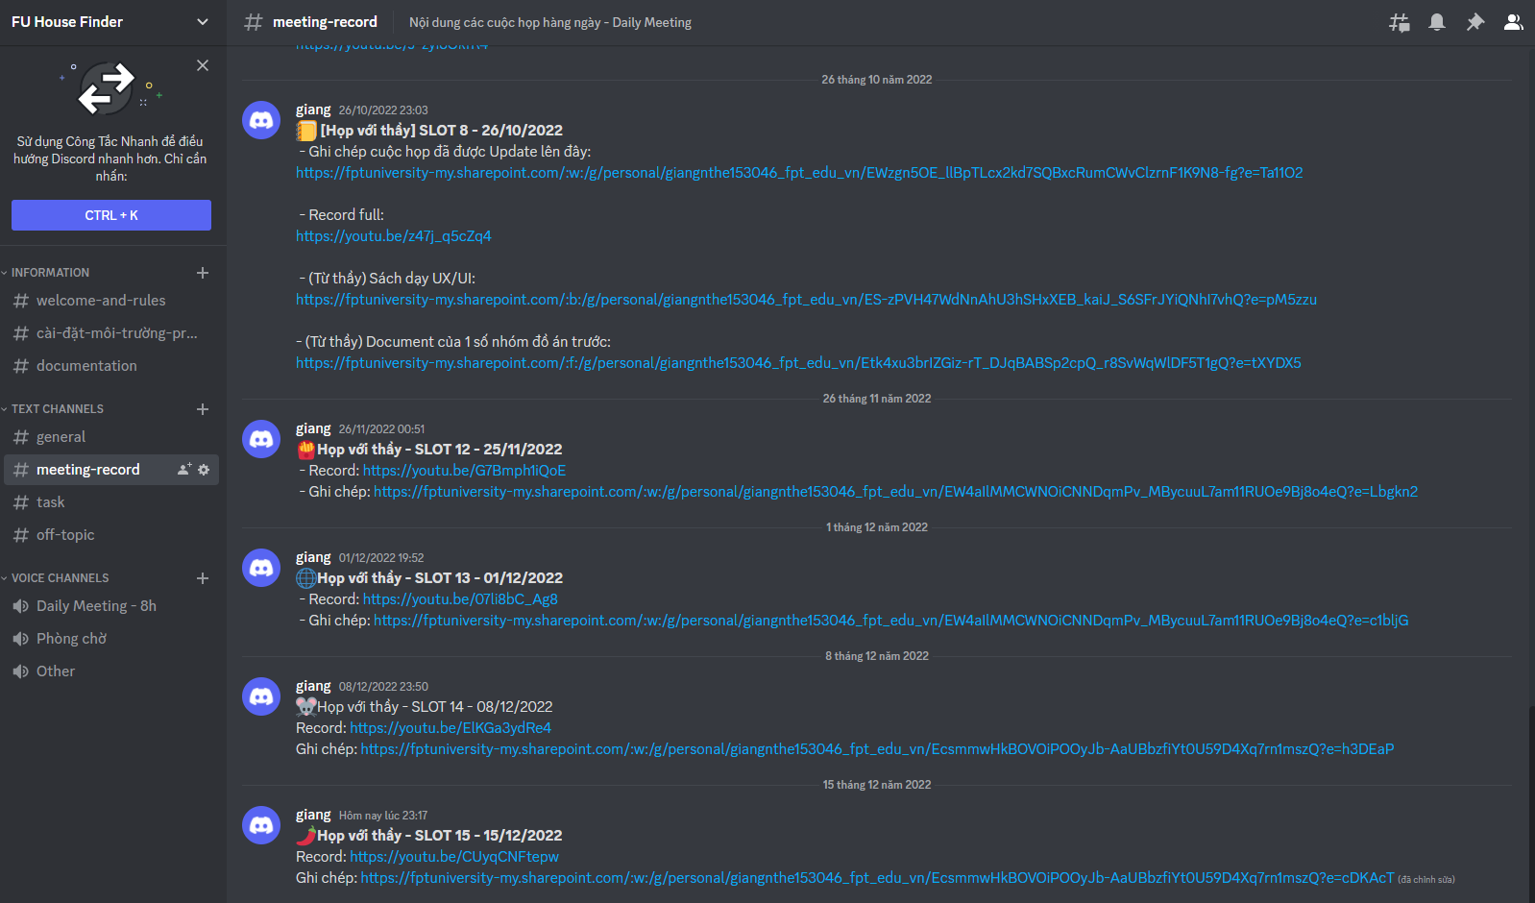
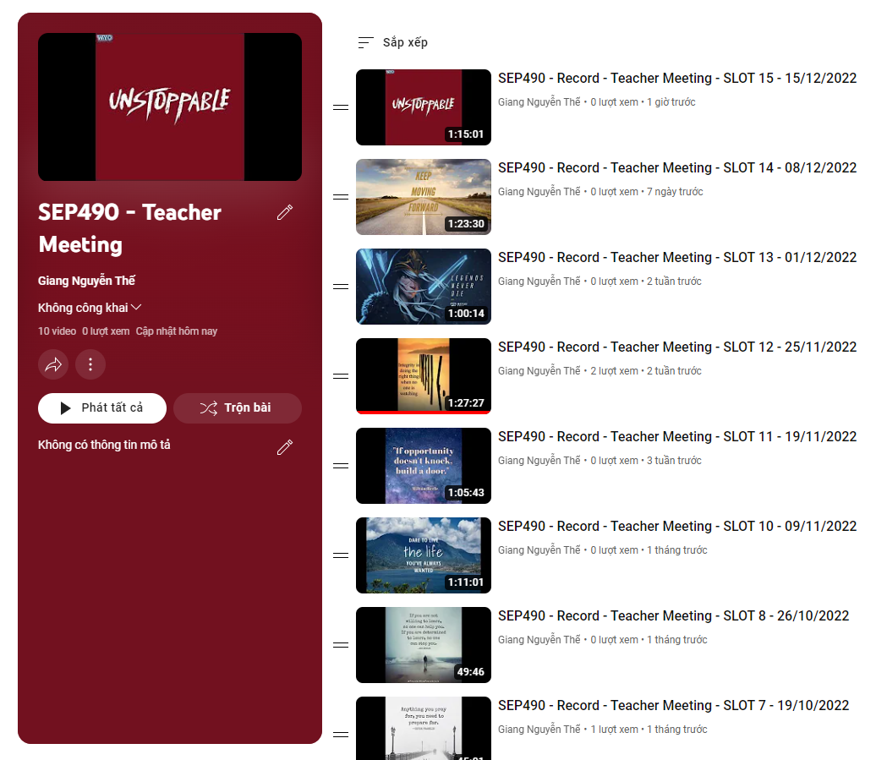
TEAM WORK
Meeting with Teacher - Record

Slide 19
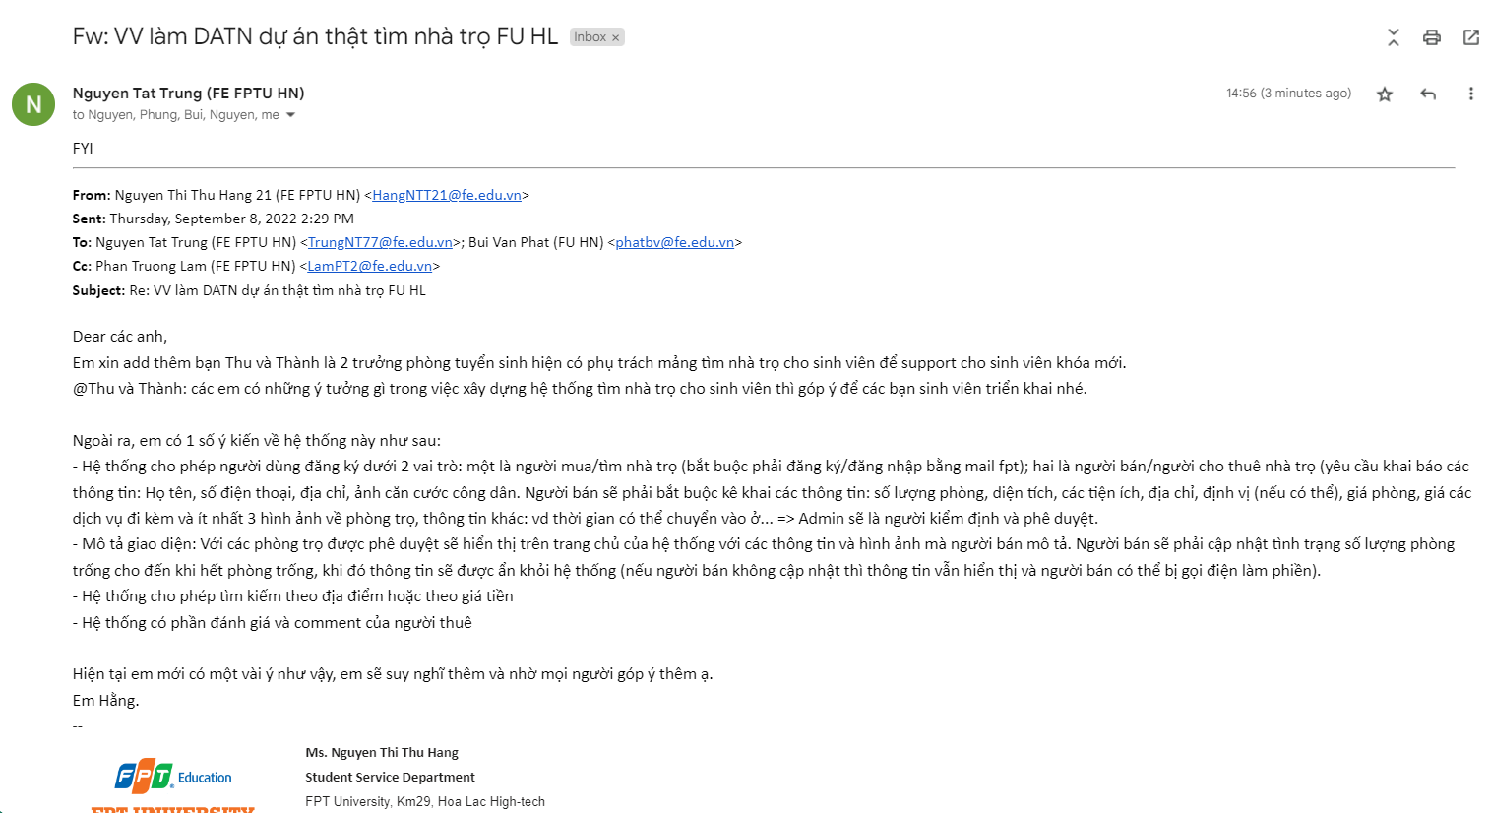
COLLECT REQUIREMENT
Supervisor contacts to Staffs to collect requirement (08/09/2022)

Slide 20
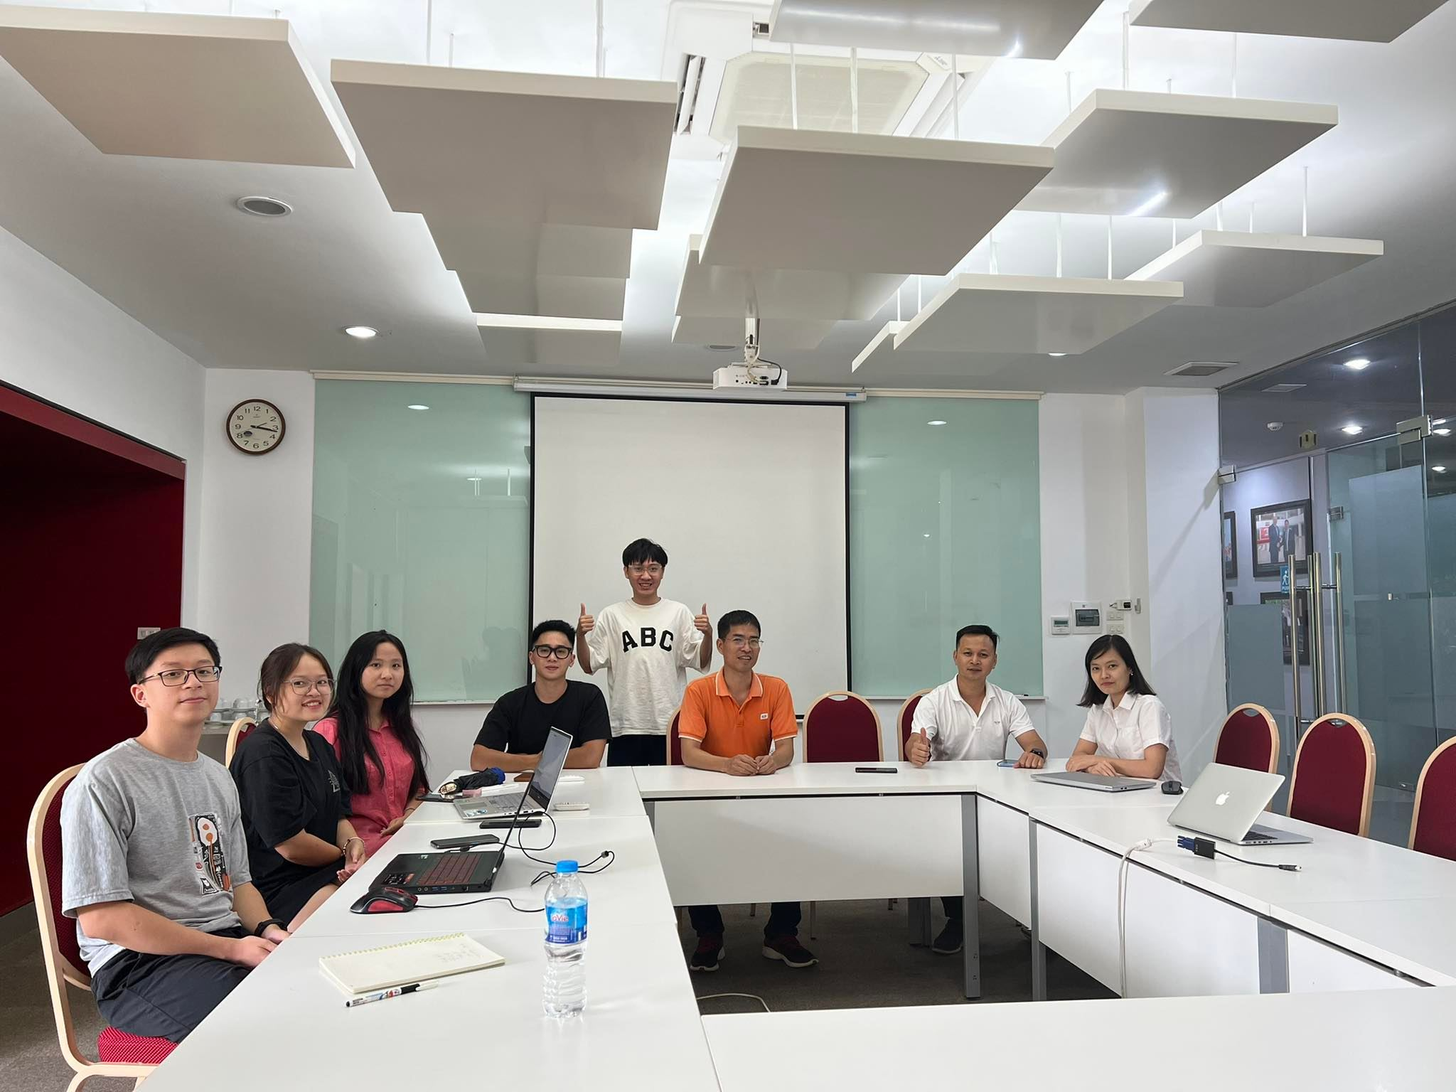
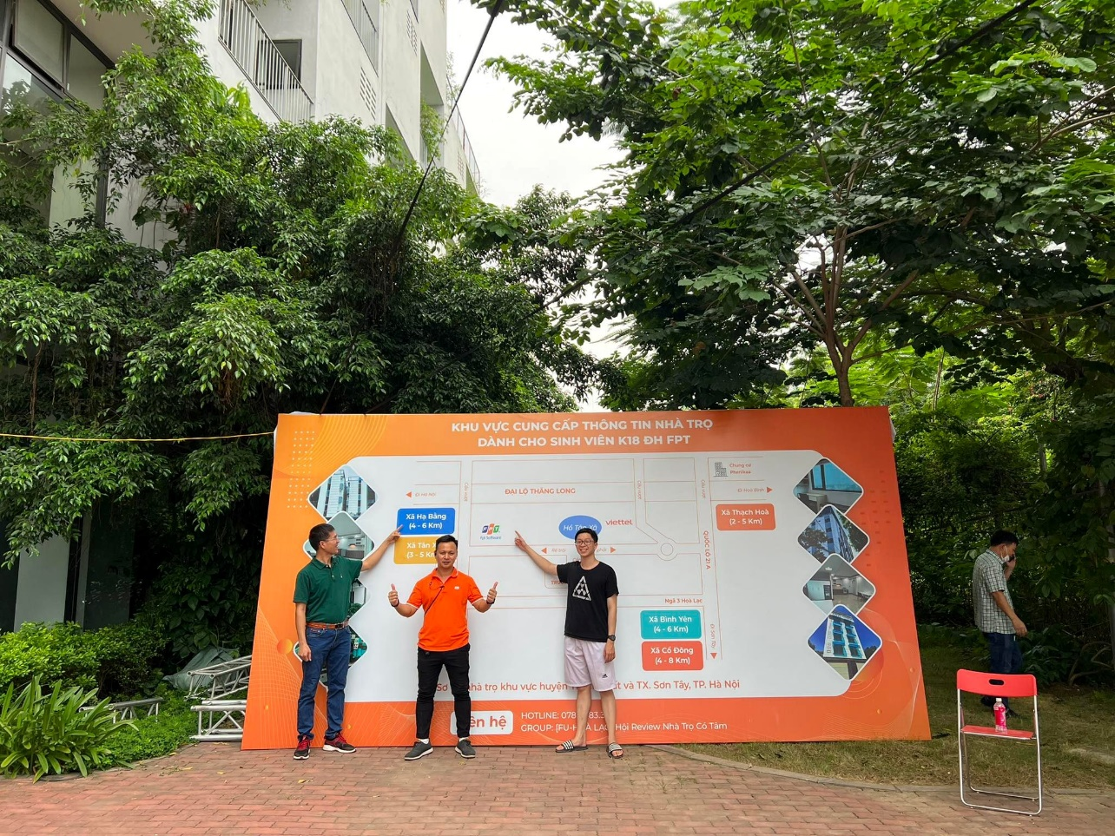
COLLECT REQUIREMENT
Meeting with Supervisor and
Staffs of the University (13/09/2022)
Meeting at the University’s Enrollment Day (16/09/2022)

Slide 21
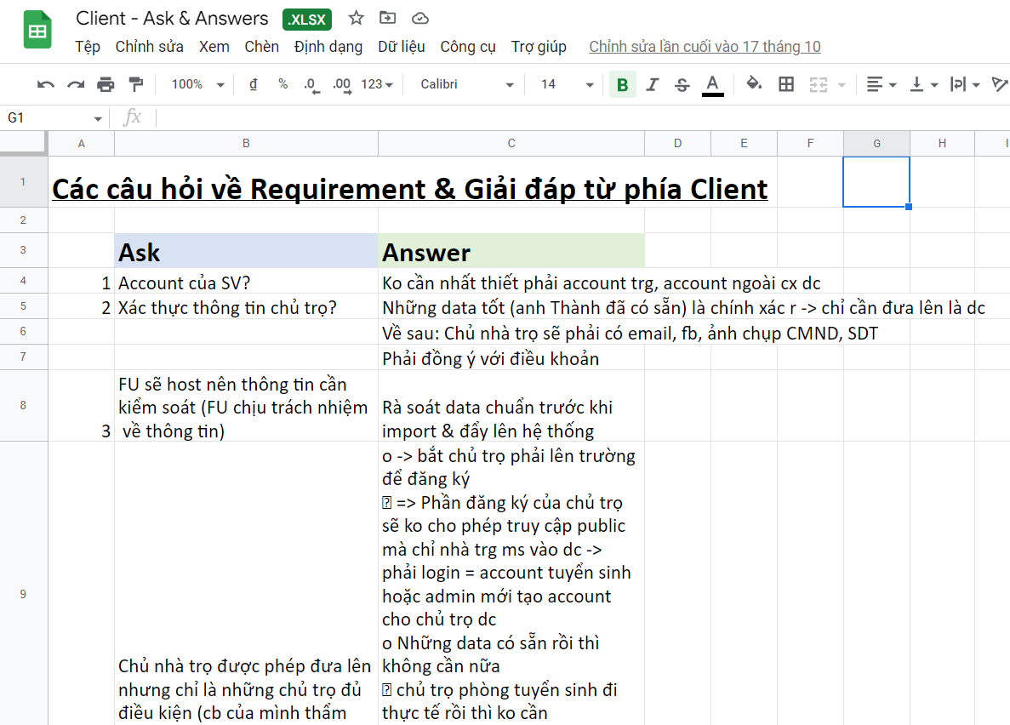
COLLECT REQUIREMENT
Meeting with Client: Staffs of University

Slide 22
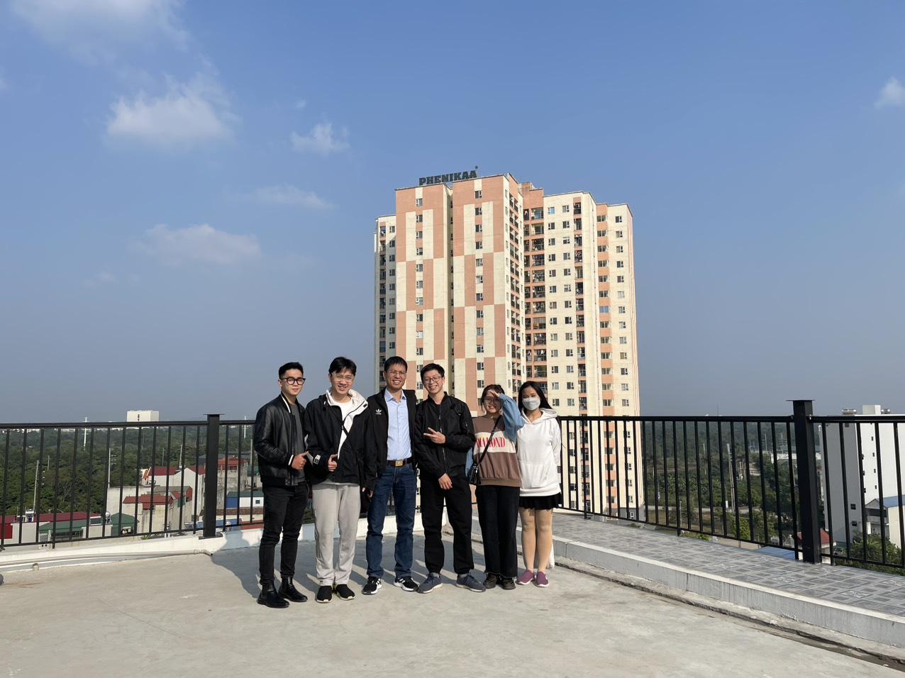
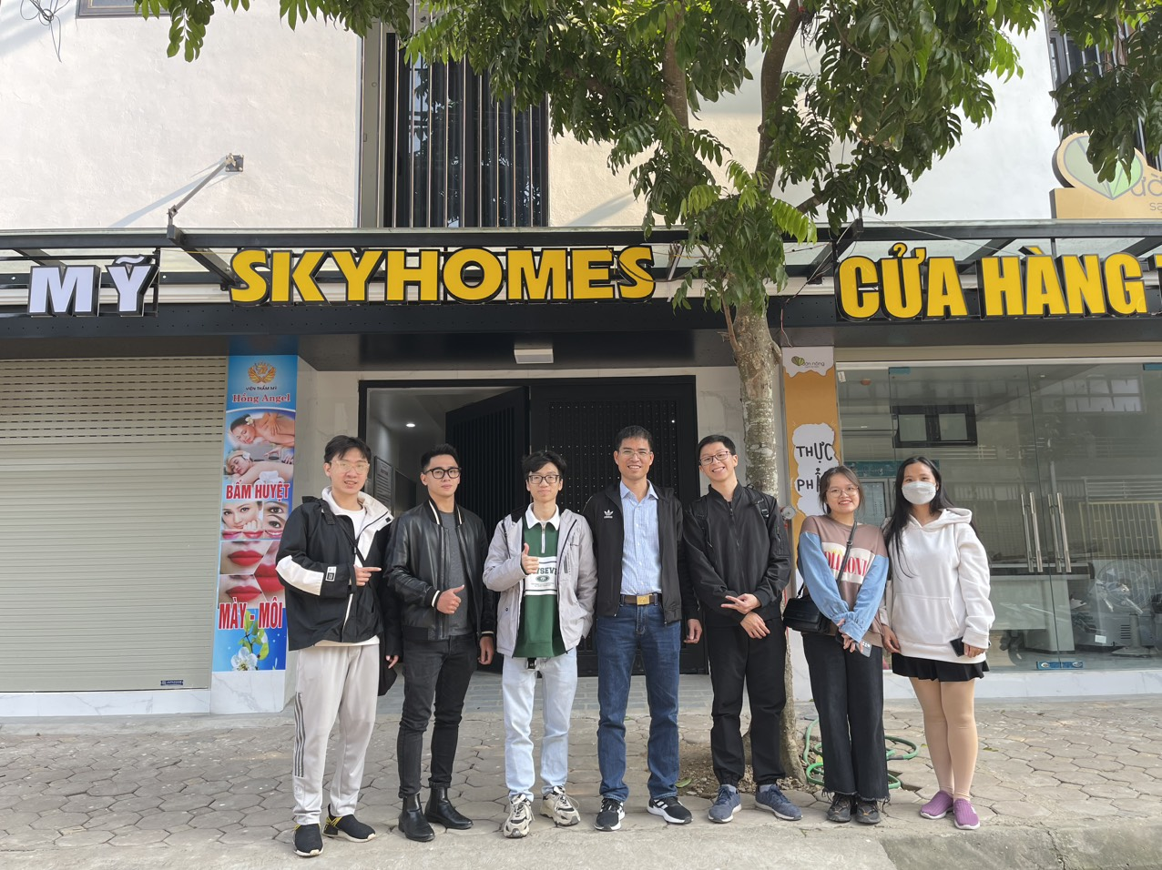
COLLECT REQUIREMENT
Meeting with Landlords to collect data (12/12/2022)

Slide 23
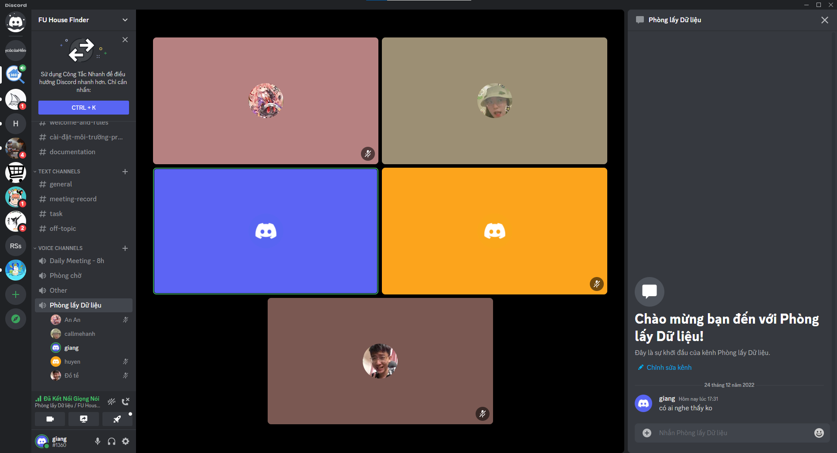
COLLECT REQUIREMENT
Meet with Landlord online, Collect data through Discord

Slide 24
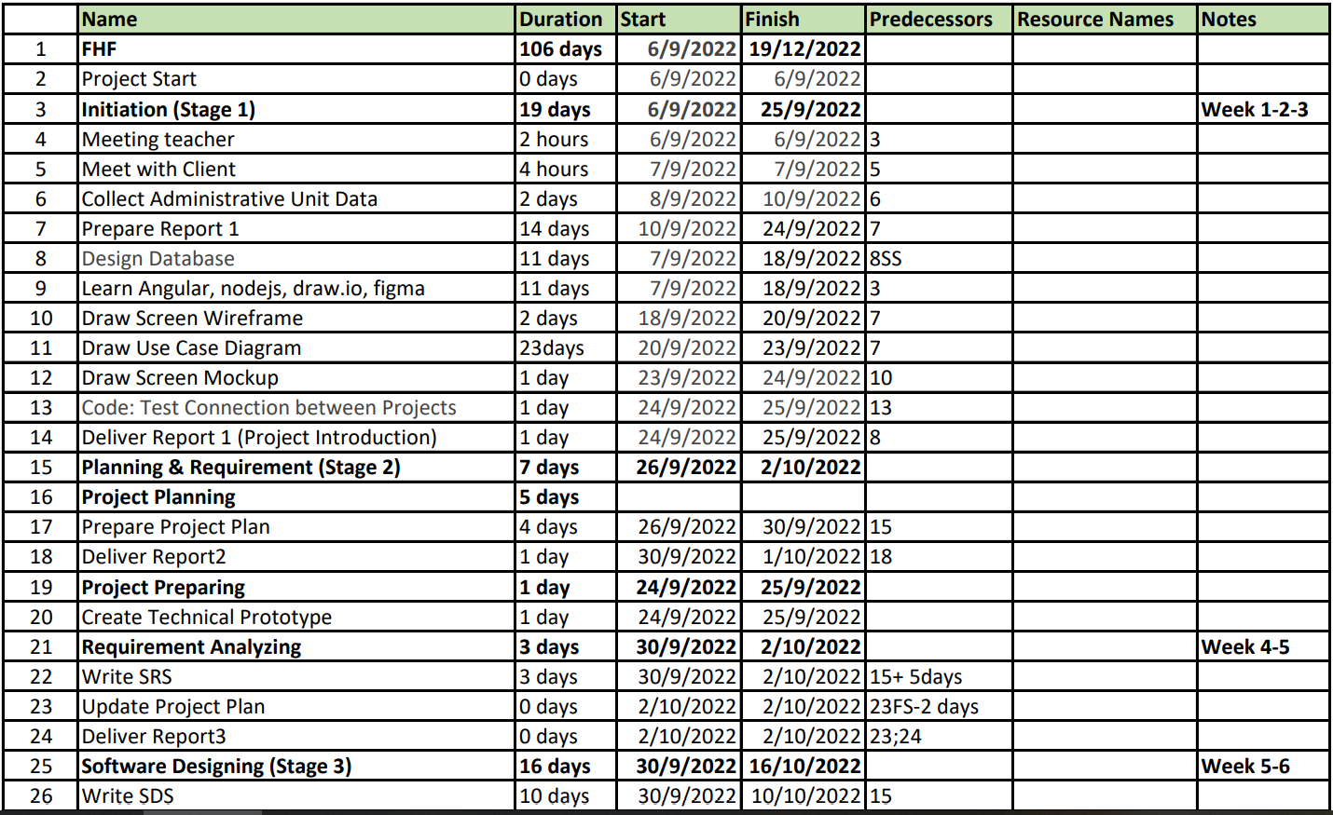
PROJECT PLANNING
Notes:
Done

Slide 25















PROJECT TOOLS
IDEs/Editors
Diagramming
Version Control
UX/UI Design
Test Tools
Communication Tools
Notes:
done

Slide 26
RISK MANAGEMENT
# | Risk Description | Avoidance plan | Contingency plan | Status
1 | Failure to meet deadline | Plan and develop schedule carefully Assign tasks carefully | Find the root cause of the problem Reassign tasks Change project scope | Closed
2 | Change in requirements | The supervisor and the entire team must review any new updates to requirements | All changes in requirements will be announced in the next daily team meeting | Closed
3 | Misunderstanding of requirements | Discuss requirements carefully with the customer Any ambiguity in understanding requirements of team members will be recorded and handed to supervisor to clarify with customer | Update code and documentation to adapt with actual requirements | Closed
4 | Illness or absence of team members | Provide meeting schedules in advance Team member must announce absence in advance | All meetings with supervisor will be recorded for absent members Assign the tasks of absent member to other members Work overtime if necessary | Closed
5 | Conflict between team members | Everything must be documented Every team member has to express clearly and carefully | Make sure any miscommunication will be resolved | Closed
6 | Data loss | Use GitHub for version control Train team members on Git usage and conflict resolution | Restore backup data from GitHub | Closed
7 | Internet connection issue in Capstone project defense | Prepare personal wireless internet connection | Demo project on localhost Record demo video before the Capstone project defense | Closed
8 | Server failure | Use paid and certified servers | Use a different server | Closed
9 | Landlords don’t want to co-operate to provide data | Explain to Landlords their benefit from providing data to the system | Contact with related Landlords | Closed
Notes:
done

Slide 27
3. REQUIREMENT SPECIFICATION

Slide 28
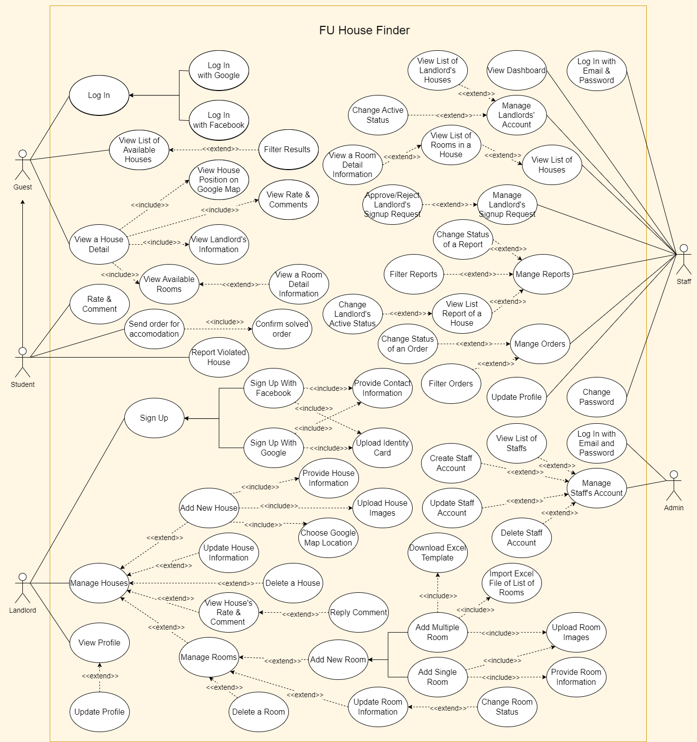
USE CASE DIAGRAM
Guest: 11
Student: 5
Use Case: 55
Landlord: 17
Staff: 17
Admin: 5
Notes:
Cho to use case ra

Slide 29

GUEST
Login (Facebook, Google)
View list of available houses
Search/Filter houses
View a house detail:
List of available rooms
Google Map location
Landlord’s information
Rate & review

Slide 30
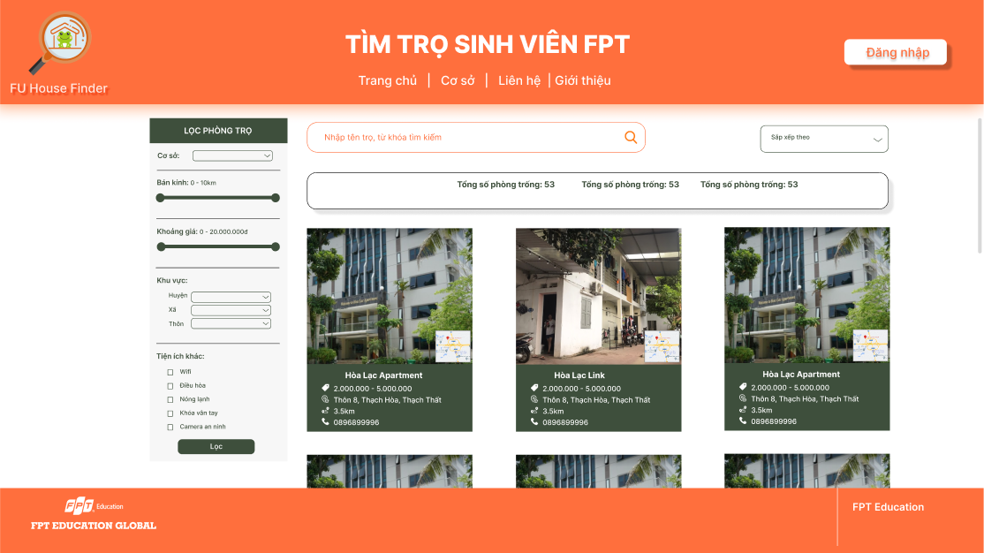
GUEST
Login (Facebook, Google)
View list of available houses
Search/Filter houses
View a house detail:
List of available rooms
Google Map location
Landlord’s information
Rate & review

Slide 31
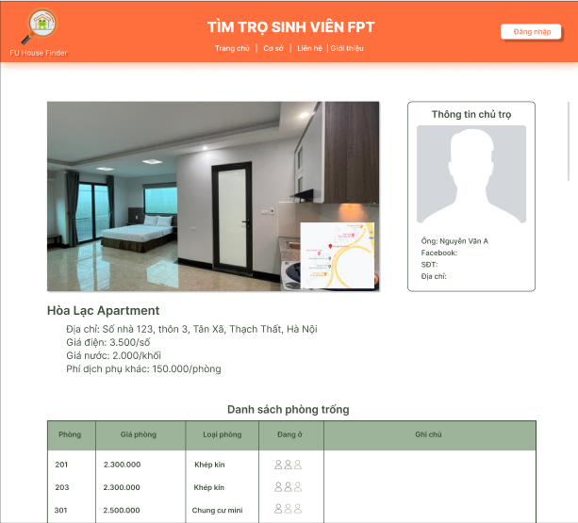
GUEST
Login (Facebook, Google)
View list of available houses
Search/Filter houses
View a house detail:
List of available rooms
Google Map location
Landlord’s information
Rate & review

Slide 32
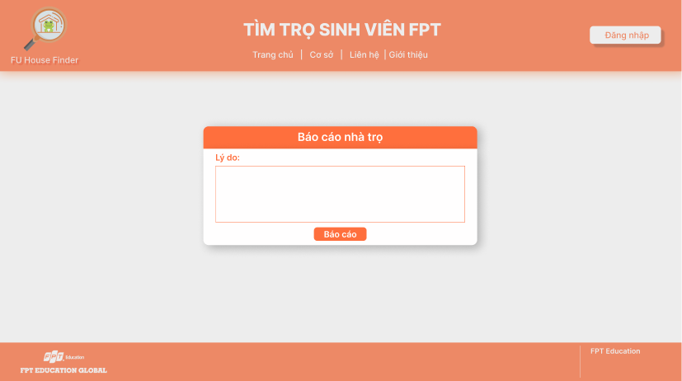
STUDENT
Send an order for accommodation
Report violated house
Rate & comment to review house

Slide 33
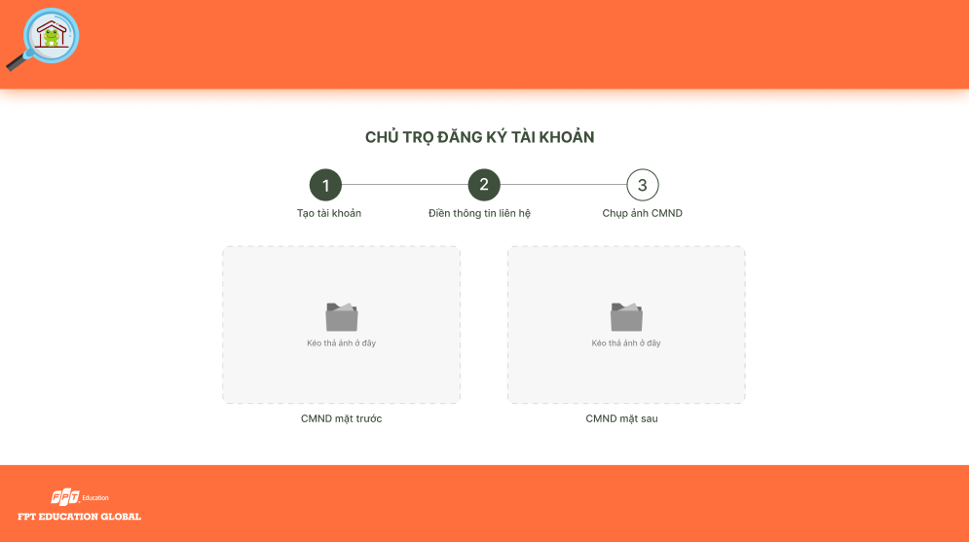
LANDLORD
Register as a landlord
Manage houses
Manage rooms
View a house’s rate and comment
Reply comment
Update profile
Notes:
Thêm hình ảnh chủ trọ import file excel

Slide 34
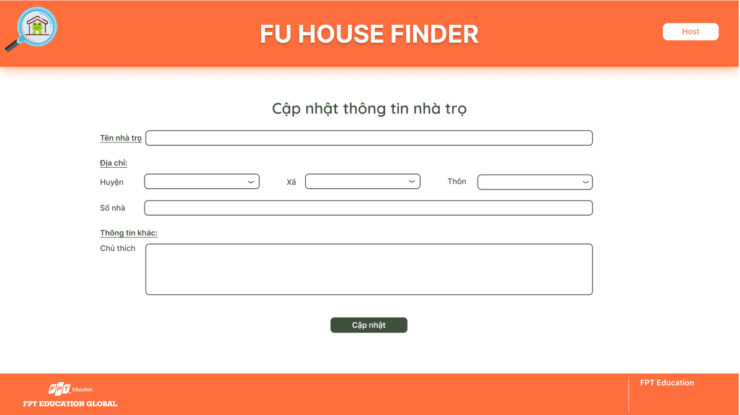
LANDLORD
Register as a landlord
Manage houses
Manage rooms
View a house’s rate and comment
Reply comment
Update profile
Notes:
Thêm hình ảnh chủ trọ import file excel

Slide 35
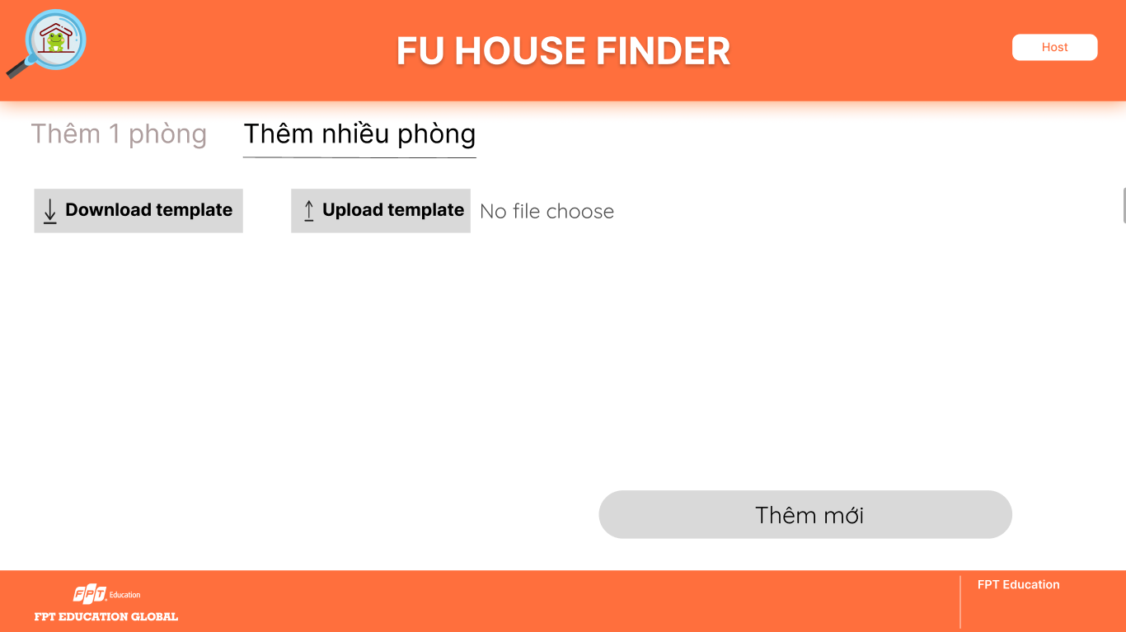
LANDLORD
Register as a landlord
Manage houses
Manage rooms: Add rooms
View a house’s rate and comment
Reply comment
Update profile
Notes:
Sửa ảnh ở slide này (template cập nhật)

Slide 36
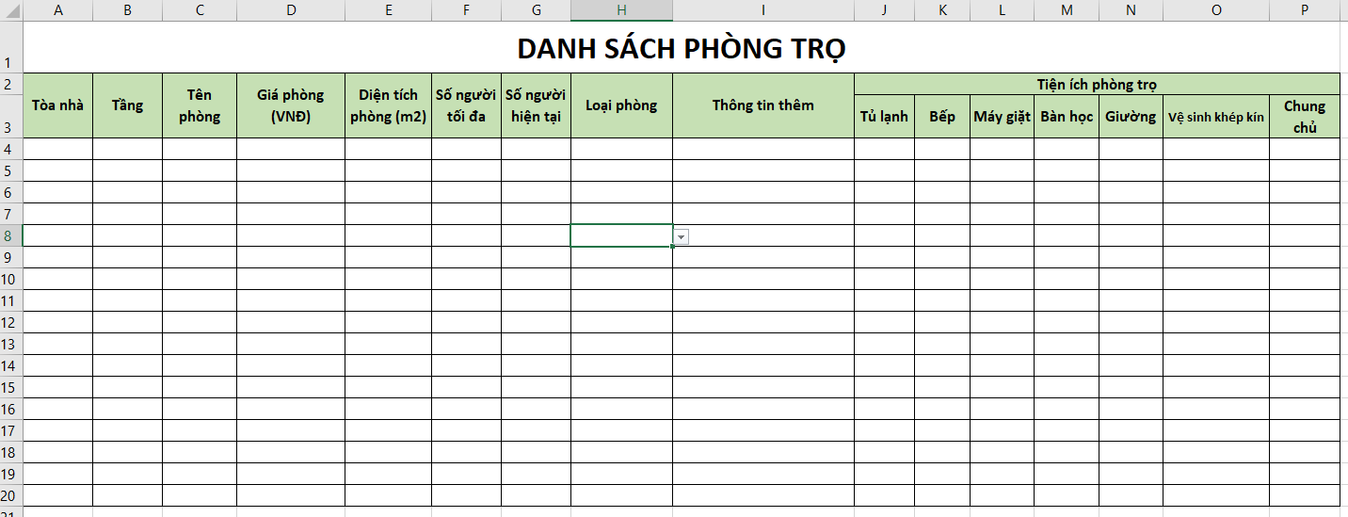
LANDLORD
Register as a landlord
Manage houses
Manage rooms: Import Excel
View a house’s rate and comment
Reply comment
Update profile
Notes:
Sửa ảnh ở slide này (template cập nhật)

Slide 37
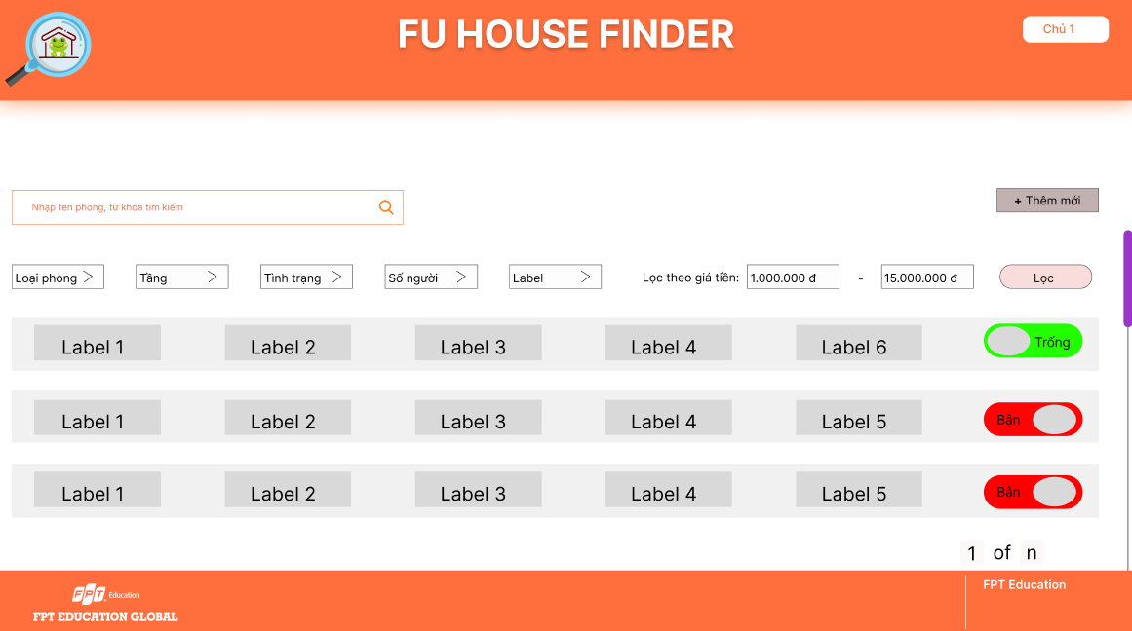
LANDLORD
Register as a landlord
Manage houses
Manage rooms: Change room Status
View a house’s rate and comment
Reply comment
Update profile
Notes:
Sửa ảnh ở slide này (template cập nhật)

Slide 38
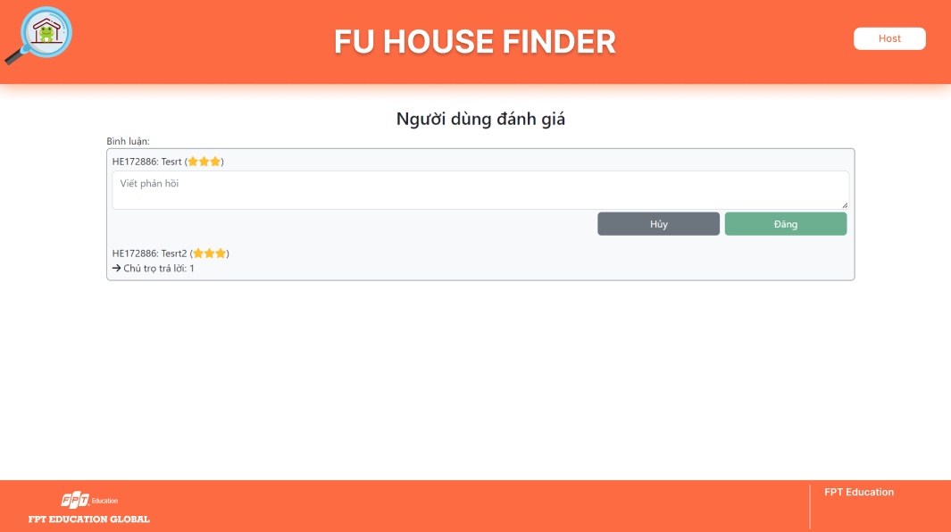
LANDLORD
Register as a landlord
Manage houses
Manage rooms
View a house’s rate and comment
Reply comment
Update profile
Notes:
Thêm hình ảnh chủ trọ import file excel

Slide 39
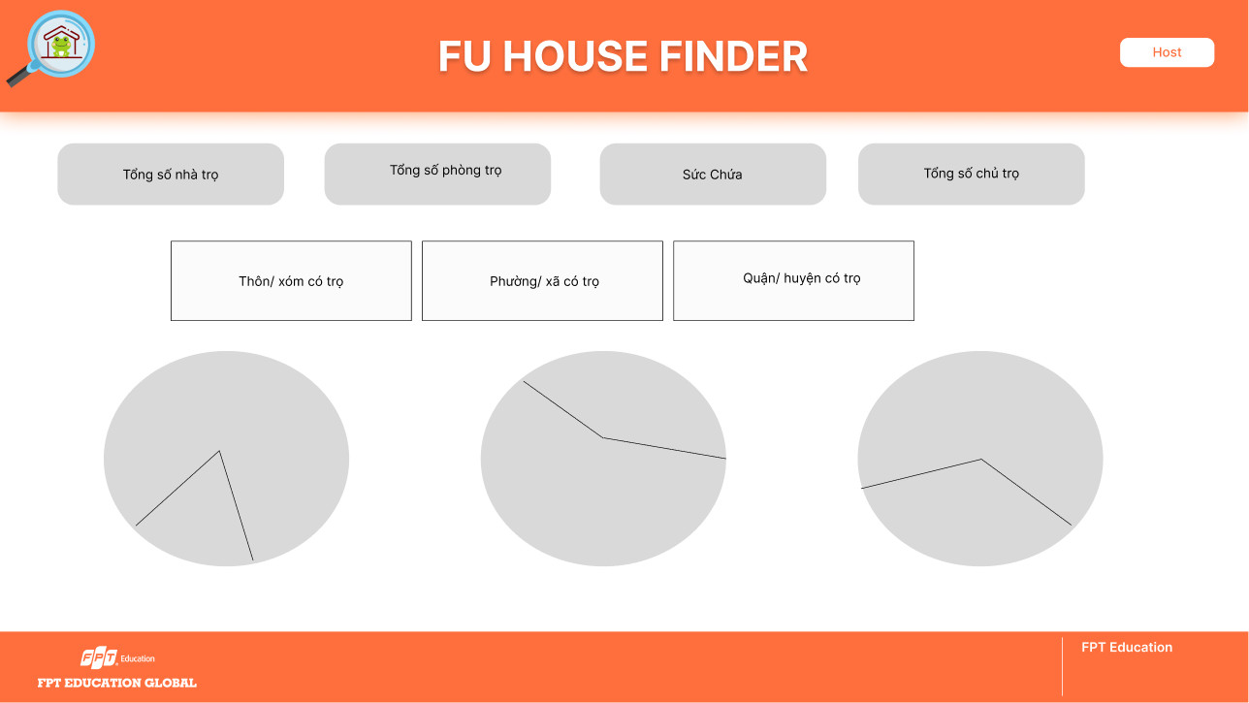
STAFF
View dashboard (statistics)
Manage landlords’ accounts
Manage landlords’ signup requests
View list of houses/rooms
Mange reports
Manage orders
Update profile/Change password

Slide 40
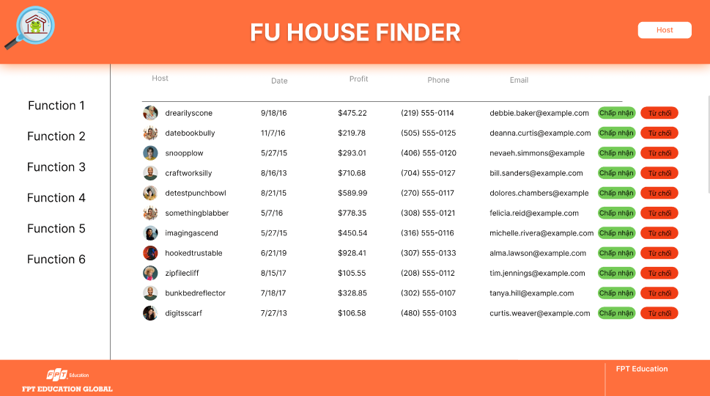
STAFF
View dashboard (statistics)
Manage landlords’ accounts
Manage landlords’ signup requests
View list of houses/rooms
Mange reports
Manage orders
Update profile/Change password

Slide 41
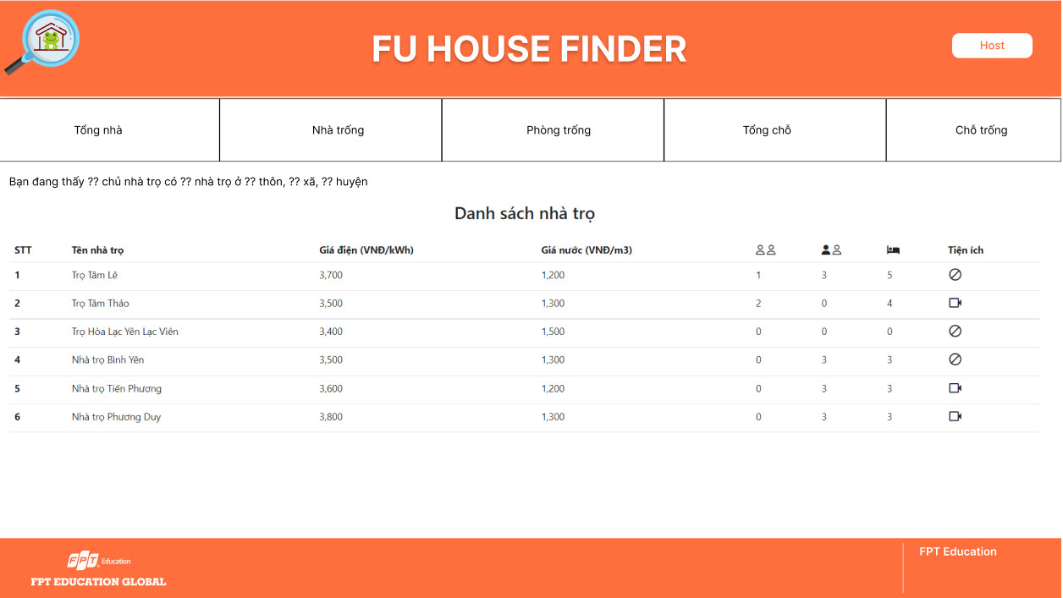
STAFF
View dashboard (statistics)
Manage landlords’ accounts
Manage landlords’ signup requests
View list of houses/rooms
Mange reports
Manage orders
Update profile/Change password

Slide 42
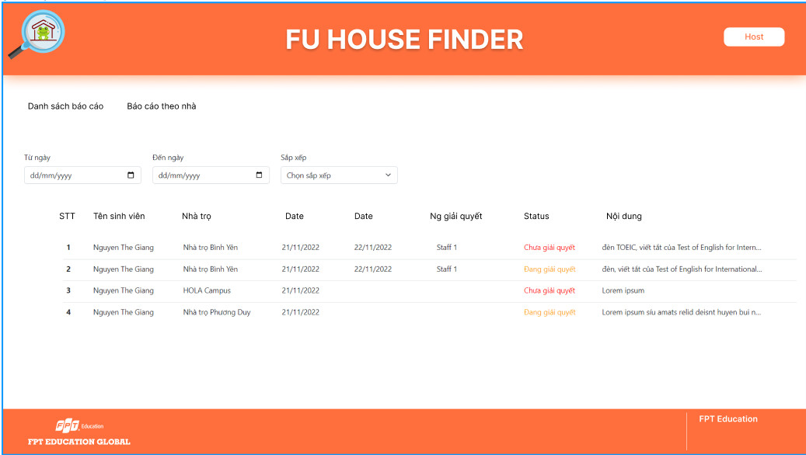
STAFF
View dashboard (statistics)
Manage landlords’ accounts
Manage landlords’ signup requests
View list of houses/rooms
Mange reports
Manage orders
Update profile/Change password

Slide 43
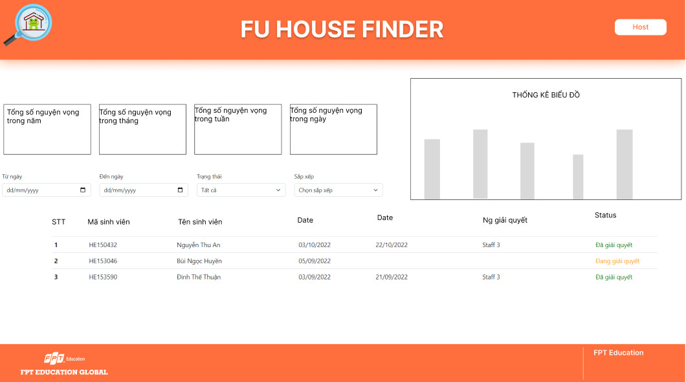
STAFF
View dashboard (statistics)
Manage landlords’ accounts
Manage landlords’ signup requests
View list of houses/rooms
Mange reports
Manage orders
Update profile/Change password

Slide 44
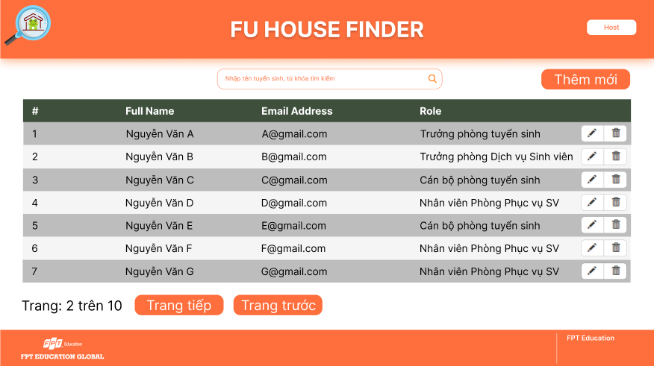
ADMIN
Manage Staffs’ accounts

Slide 45

NON-FUNCTIONAL REQUIREMENTS
USABILITY
The maximum number of mouse click any user role has to perform to get to any place they want in the system is 4
The theme color of the website is Orange, following the theme color of other websites in the FPT Education system
All ambiguous icons will have explanatory tooltips to help user understand
Actions that require multiple steps will have no more than 5 steps to ensure that user can remember them all, following the Miller’s Law
Website is responsive on most of screen sizes

Slide 46
4. SOFTWARE DESIGN

Slide 47
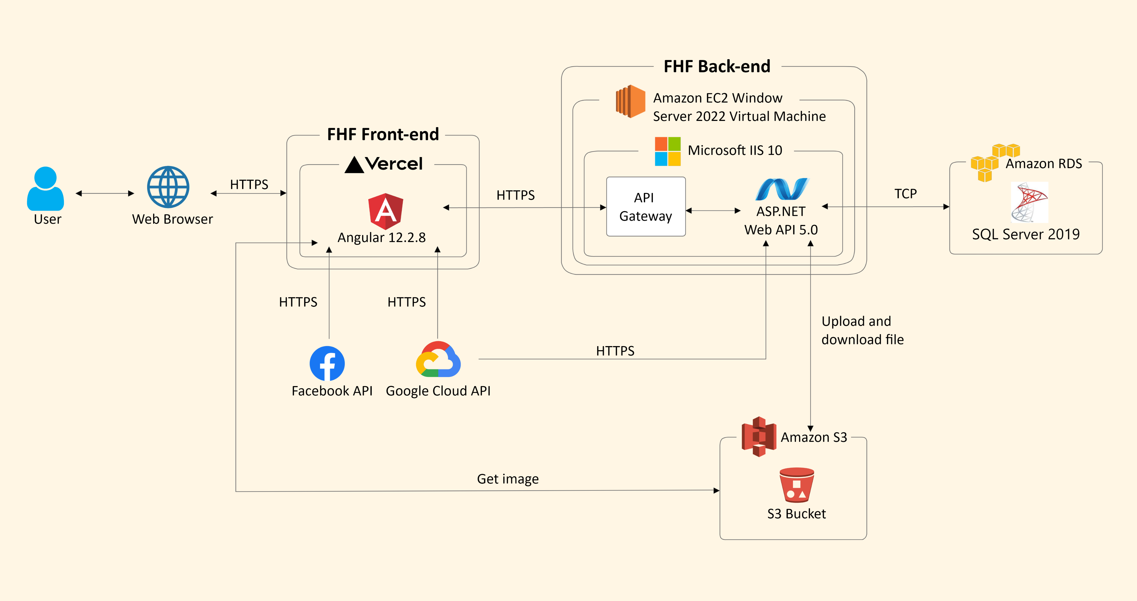
OVERALL ARCHITECTURE
Notes:
done

Slide 48
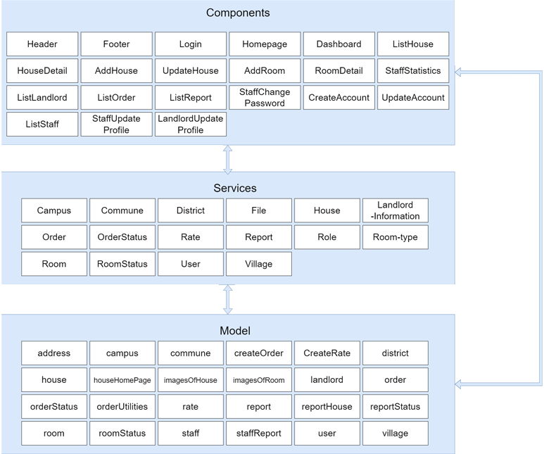
FRONT-END
LAYERS DESIGN

Slide 49
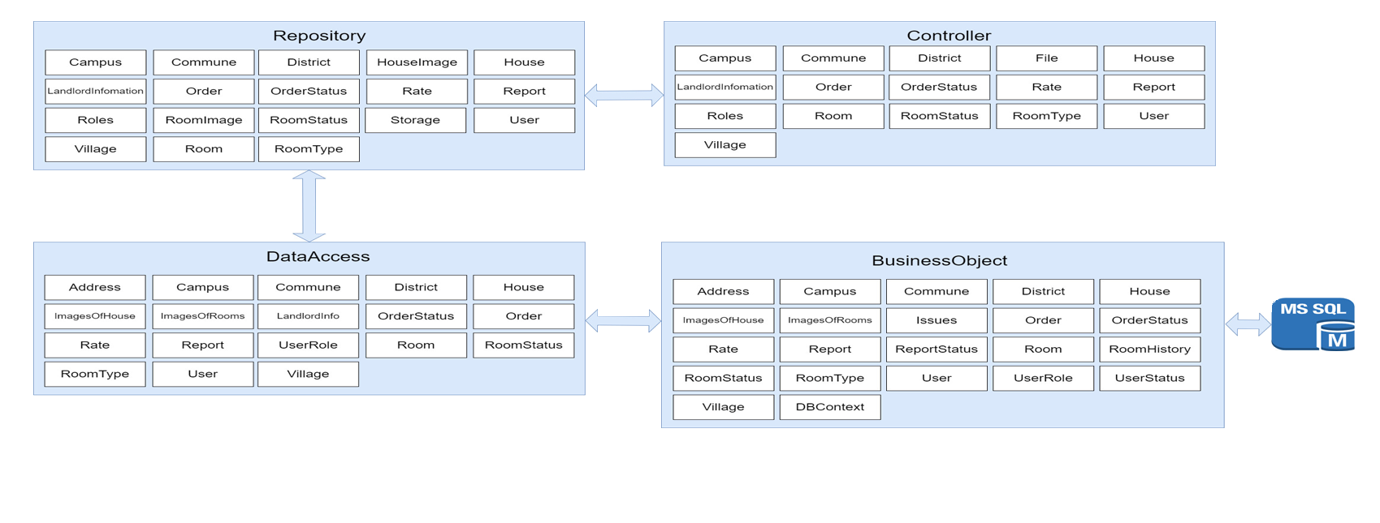
BACK-END
LAYERS DESIGN

Slide 50
UPLOAD FILE
CHECK FILE TYPE
PSEUDO CODE
if file_extention != type_extension
return false
byte[] buffer = new byte[16]
stream fs = file.openreadstream()
if fs.length > 16
fs.read(buffer, 0, 16)
else
fs.read(buffer, 0, fs.length)
string hexdata = buffer
if hex_data = type_magic_number
return true
else
return false

Slide 51
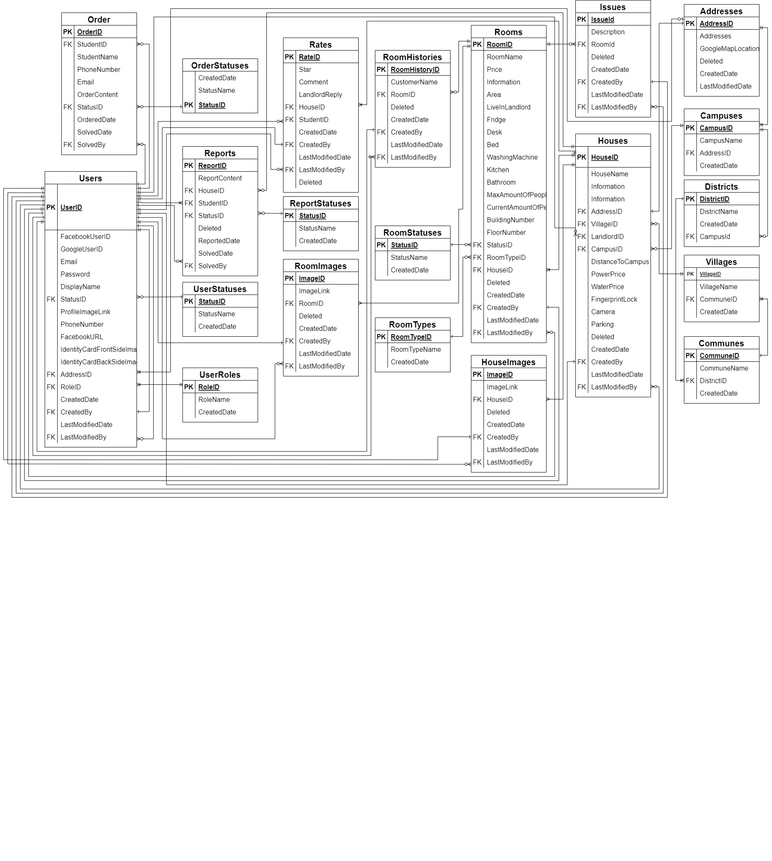
DATABASE
DESIGN

Slide 52
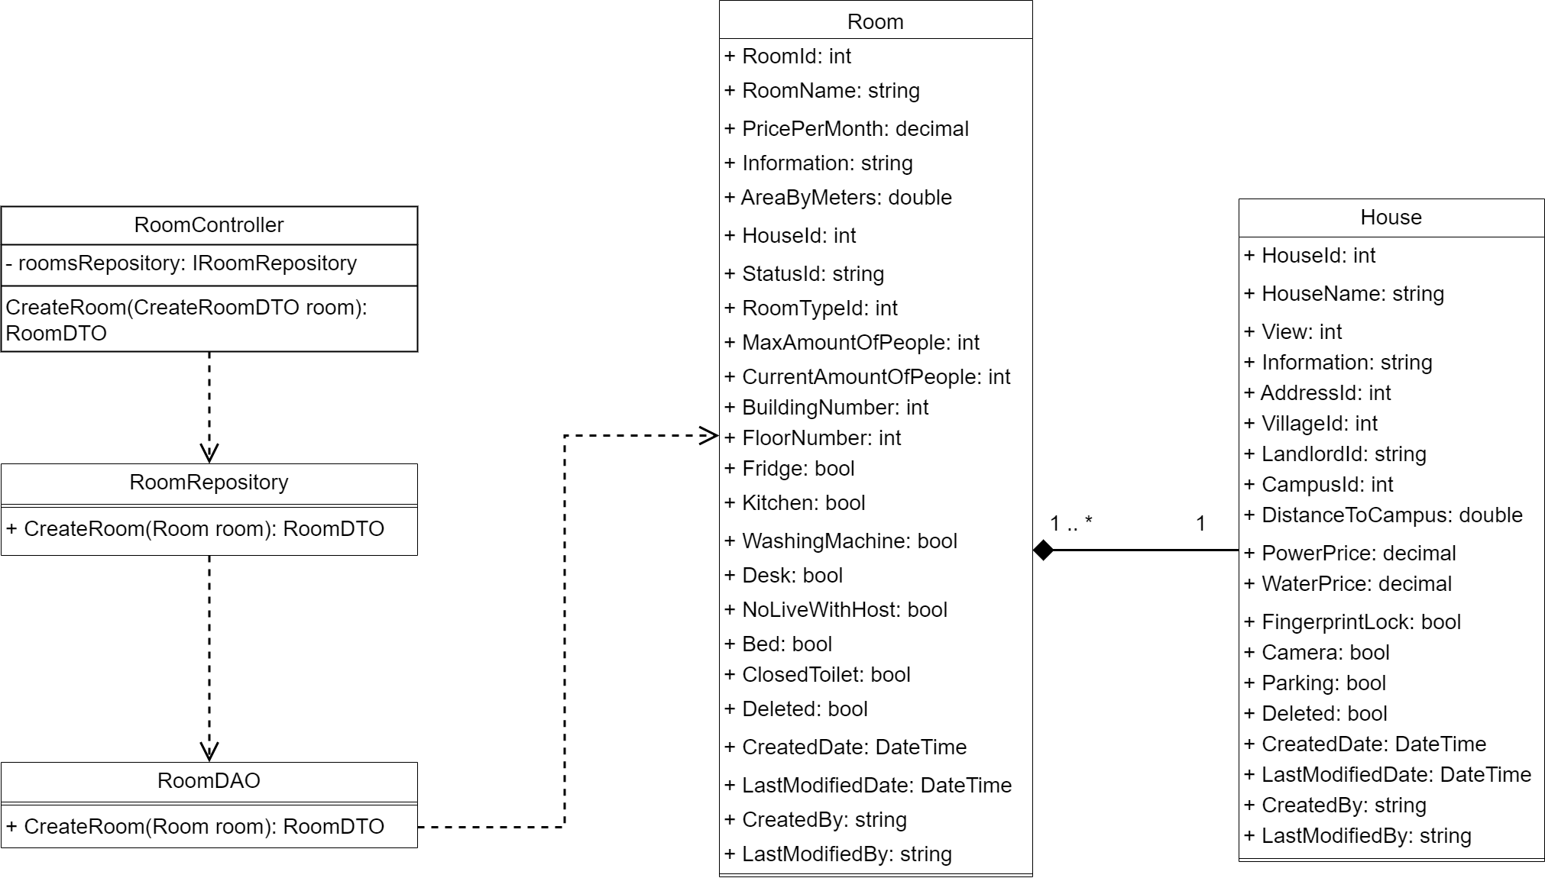
CLASS DIAGRAM

Slide 53
5. TESTING

Slide 54
Unit Testing
API Testing
TESTING TYPES
Integration Testing
System Testing
Acceptance Testing

Slide 55




TESTING TOOLS
Chrome Devtools
Swagger
Postman
NUnit
Fluent Assertions
Excel
Github
Microsoft Excel
GitHub Issues
Notes:
Done

Slide 56
TESTING ENVIRONMENT
SOFTWARE
HARDWARE
Microsoft Excel 2016
Microsoft Word 2016
Google Chrome version 108.0.5359.125
GitHub Issues
OS: Window 10 Home 64-bit
CPU: Intel® Core™ i5
RAM: 8.00GB

Slide 57
TEST SCHEDULE
26/09/2022
30/10/2022
18/12/2022
Phase 1:
Unit Testing
Regression Testing
API Testing
Integration Testing
Phase 2:
Unit Testing
Regression Testing
API Testing
Integration Testing
System Testing
Acceptance Testing

Slide 58

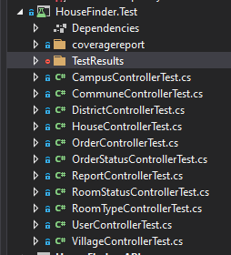
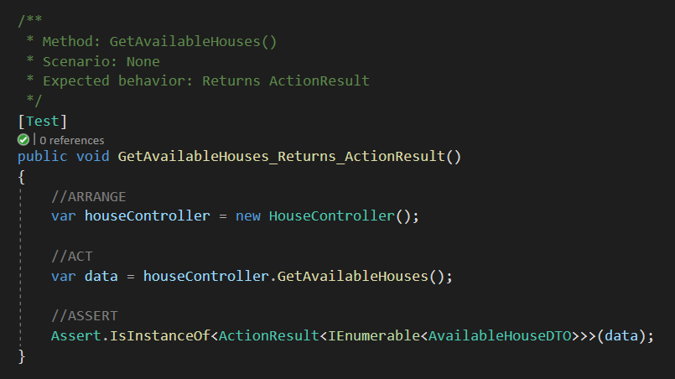
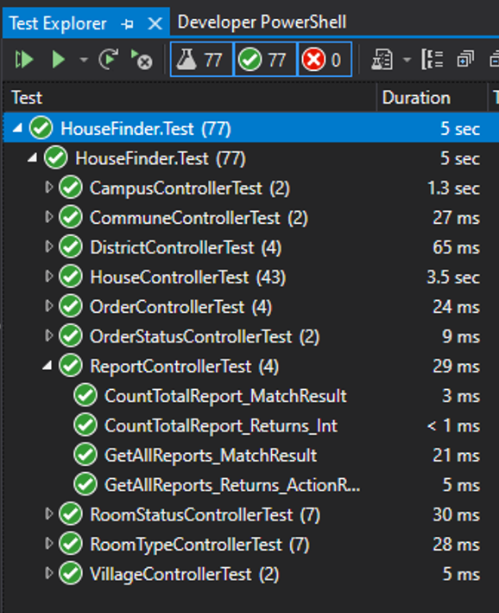
SAMPLE TEST CASE:
Automation Test with Unit Test
Test Project’s
directory structure
Sample Test case
Test Result

Slide 59

SAMPLE TEST CASE:
Automation Test with Unit Test
Generate Code coverage
Code coverage report

Slide 60


SAMPLE TEST CASE:
API Testing
With Swagger
With Postman

Slide 61

SAMPLE TEST CASE:
Integration Test

Slide 62

SAMPLE TEST CASE:
System Test

Slide 63


DEFECT LOG:
Control bugs with GitHub Issues

Slide 64
DEFECT LOG:
Unit Test Summary Report
Phase | Date | Pass | Failed | Untested
1 | 26/09/2022 | 27 | 0 | 0
2 | 31/10/2022 | 31 | 0 | 0
Total number of test cases |  | 58 | 0 | 0

Slide 65
DEFECT LOG:
Unit Test Code Coverage Report
Phase | Coverage
 | Statements | Branches | Functions | Lines
Phase 1 | 97.22% | 100% | 92.31% | 98.25%
Phase 2 | 94% | 90% | 91.3% | 96.25%

Slide 66
DEFECT LOG:
Integration Test Summary Report
Phase | Date | Pass | Failed | Untested
1 | 26/09/2022 | 157 | 0 | 0
2 | 31/10/2022 | 374 | 0 | 0
Total number of test cases |  | 531 | 0 | 0

Slide 67
6. LESSION LEANRED

Slide 68
T
O
Teamwork
M
Overcome Difficulties
Management Skill
L
Leadership Skill

Slide 69

7. DEMO – Q&A

Slide 70

THANKS FOR LISTENING

